Slide 1
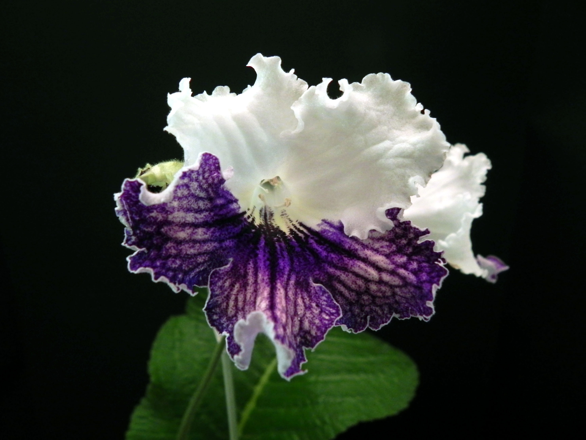
Welcome To The Wonderful World
Of Streptocarpus

Slide 2
What is a Streptocarpus?
Member of the Gesneriad family
From Greek words streptos (twisted) & karpos (fruit)
Common name: Cape Primrose
Native to parts of Africa & Madasgascar
163 species are recognized by the Gesneriad Society
Long leaves in a basal rosette and flowers like primroses
First strep introduced into this country: Streptocarpus rexii in 1826
First modern named hybrid was 'Constant Nymph', bred at the John Innes Institute in 1946
Prized by collectors because of their large blooms & infinite color varieties

Slide 3
Types of Streptocarpus
Grandiflora – Large bloom 1-2 per stem, large leaves as well
Multiflora – Many medium or small blooms per stem
Unifoliate – One large leaf with many blooms on multiple stems
Variegated – have variegated leaves
Standards – plain green leaves with single 5-6 petal blooms
Color Changers – blooms open as one color & change to another color as bloom matures
Scented – any hybrids crossed with S. Vandeleurii species – blooms will have a scent

Slide 4
Cousins of African Violets
Similar growing conditions
Can be wick or top watered
Like AV s, they do not like to have their feet wet
Can have the same pest problems
AV fertilizer can be used but at a higher rate – never use a bloom booster. High nitrogen is toxic to streps
Same soil mix with 1/3 more perlite
Same light conditions as AVs but add 2 more hrs. per day
Prefer more air circulation than AV s
Both prefer high humidity
Can be propagated the same as AV s but also by root division

Slide 5
Reasons To Love Streps
Large, beautiful blooms in an infinite variety of colors
Fast growers: you can propagate a leaf & have a plantlet bloom in less than 4 months
Ease of grooming: multiple crowns & trimming of leaves are ok for show
Ease of propagation: grow from a leaf or root division
They bloom constantly with no dormant periods
Less susceptible to insects than AV s & other houseplants
Can be revived if plant droops from lack of water
They come in a larger variety of color combinations than AVs

Slide 6
Strep Care
12-14 hrs of bright indirect sunlight per day (9-12 on a light stand)
Ideal temperature between 70-80°F
Wick/top water with fertilized water @ ¼ tsp per gallon
Use 40% soiless mix with 60% extra coarse perlite added.
Prefer high humidity
Trim 1/3 of tallest leaf when there are only 2 leaves
Good air circulation is key to prevent mold & fungus.
Repot @ 3 months for babies & young plantlets & @ 6 months for mature plants.
Trim leaves with brown edges & extra long ones when there is little center growth
Remove old leaves that have no new bloom stalks. Leave a small stub for new plants to form

Slide 7
Strep Propagation
Root Division – Mature plants can be separated like day lilies
Leaf Cuttings – Soak leaves in water & a drop of Superthrive at least 1 hour before planting
Plant leaf as you would an African Violet
Cut leaf in 3” portions, insert 1/8” into moist soil
Remove main vein, dust cut edges with Rootone & plant 1/8” to 1/4” in soil
Seed – Sow seed on top of moist, fine, peat. Place in clear sealed container 2-4” below a bright light. Seed should sprout in 2 – 4 weeks.

Slide 8
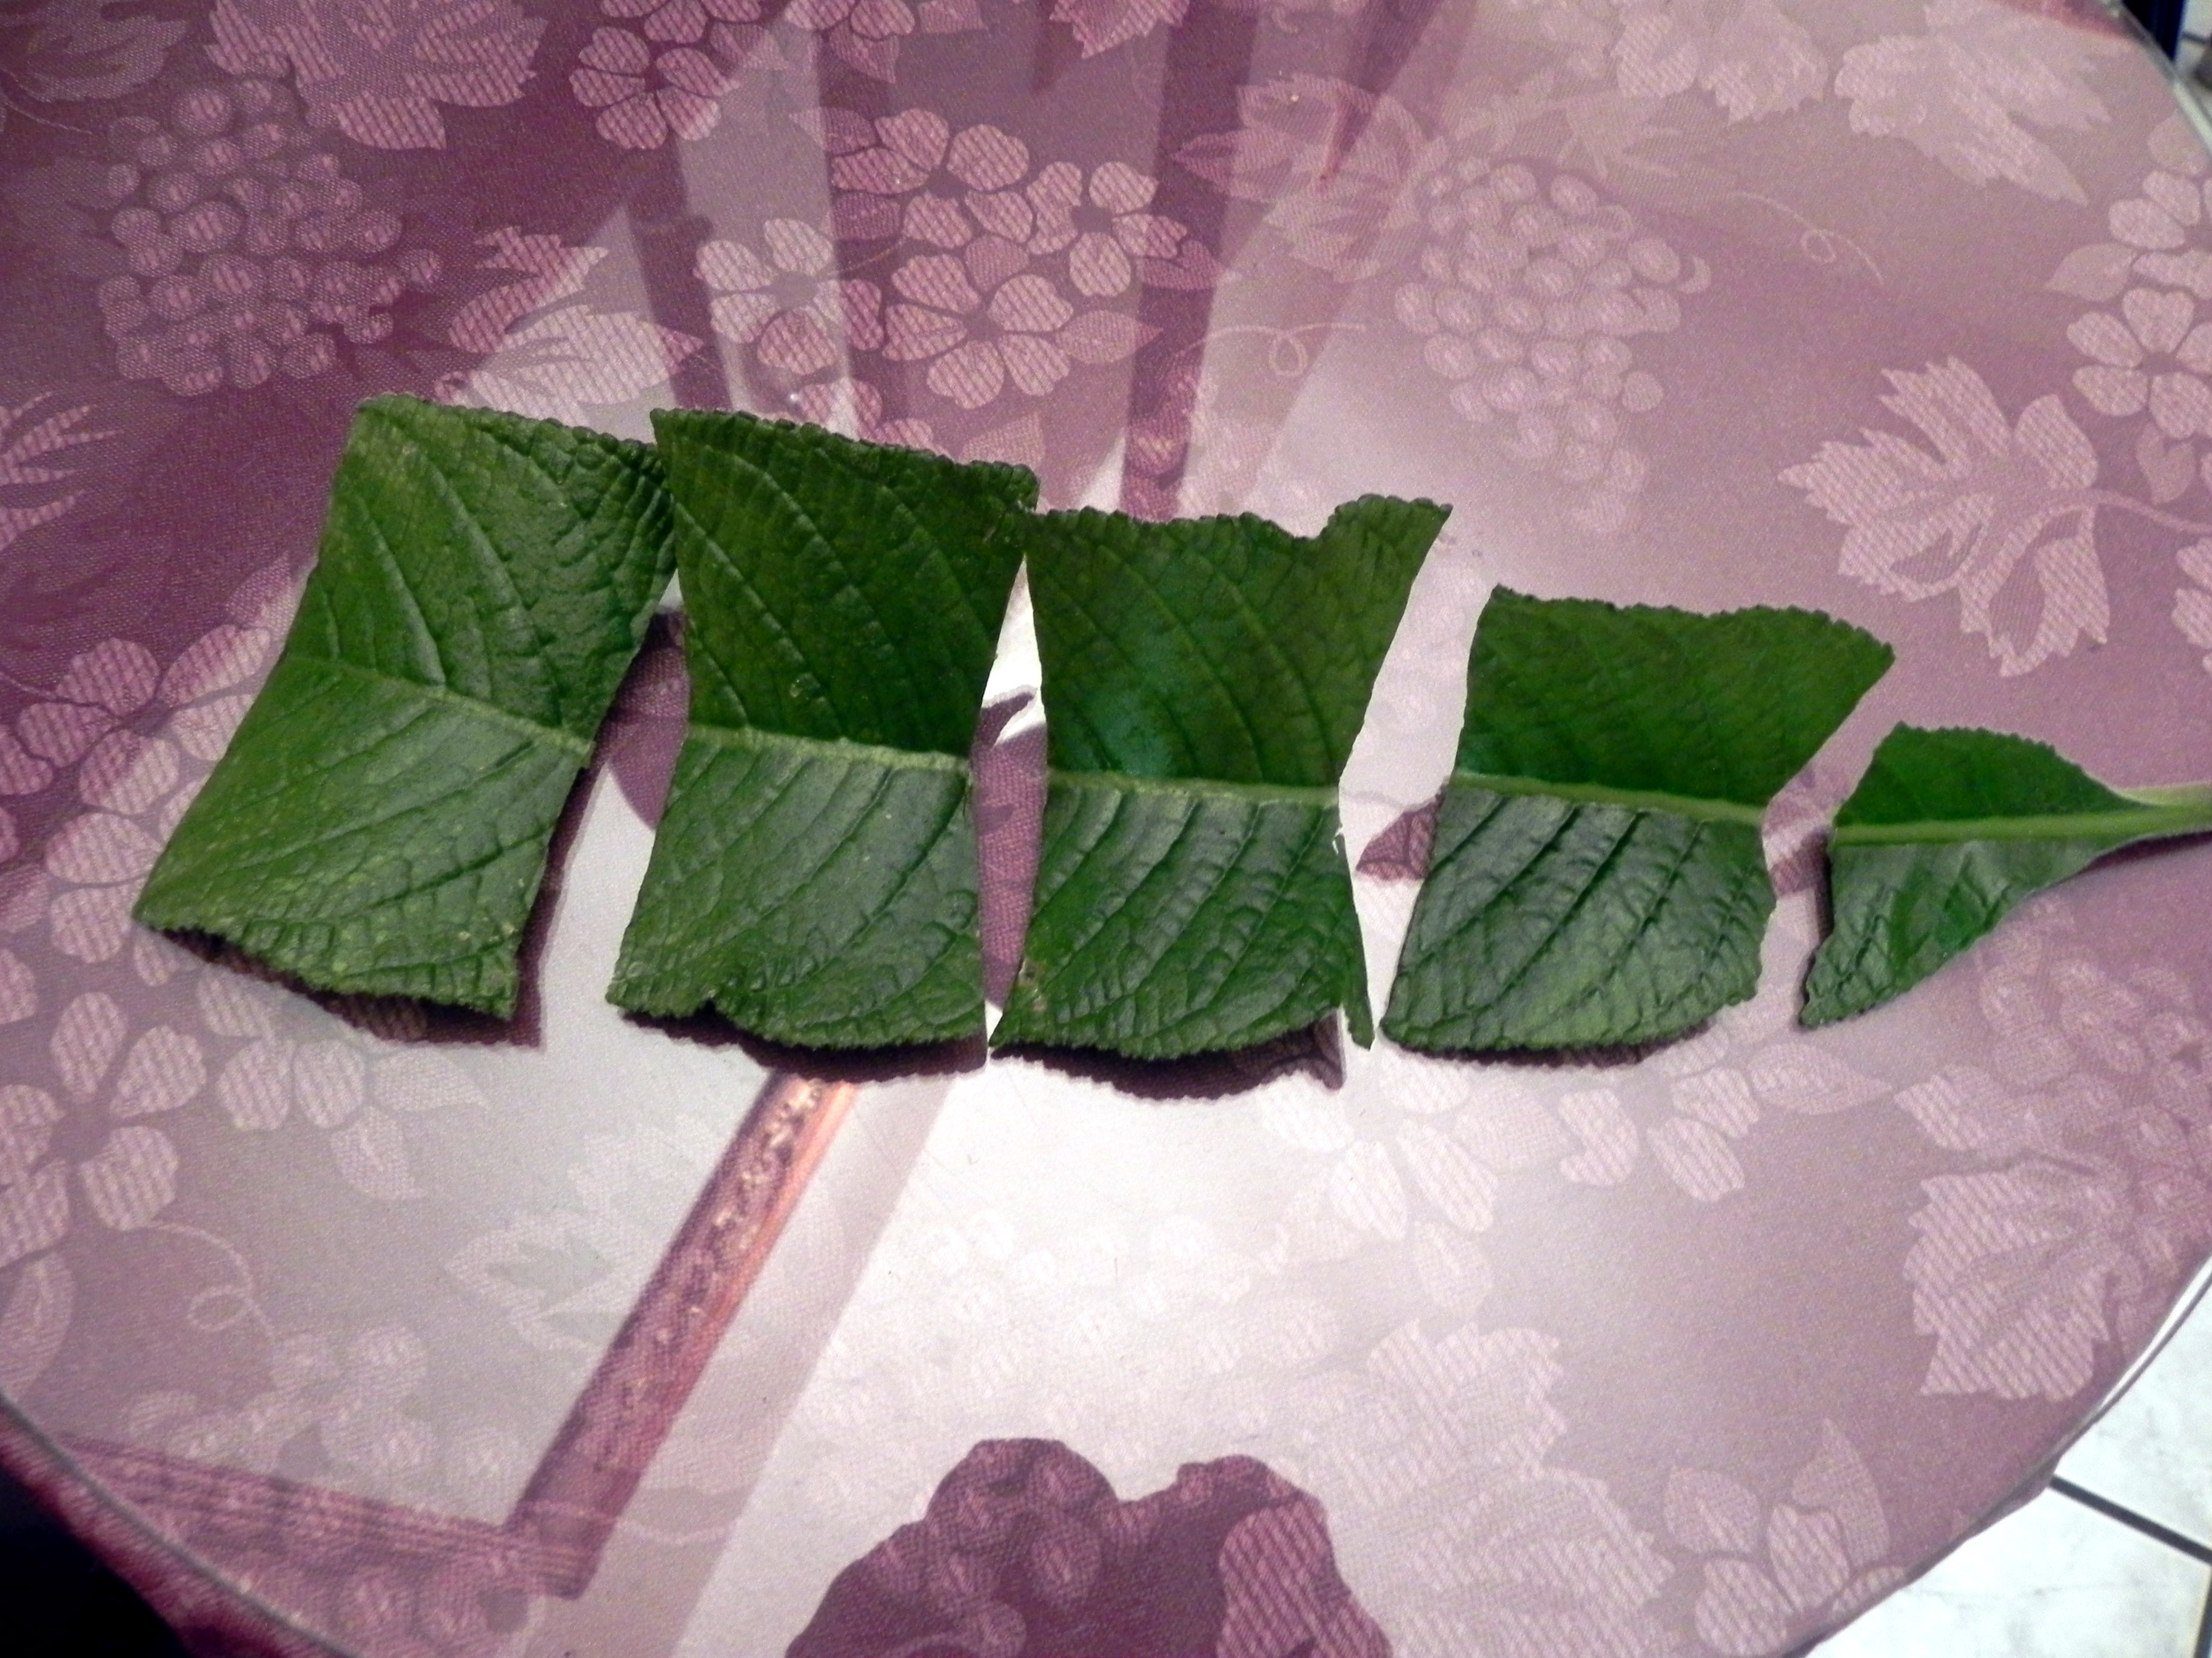
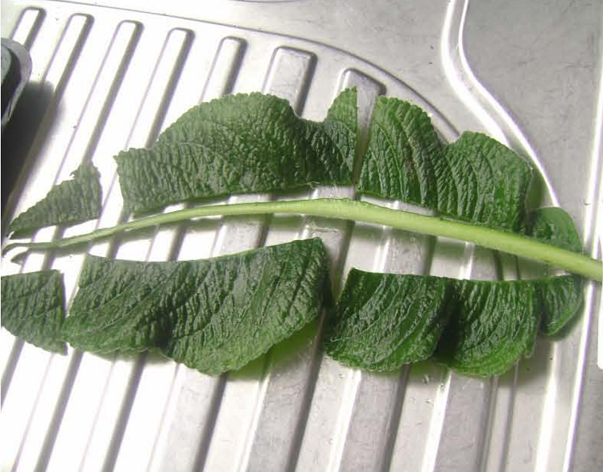
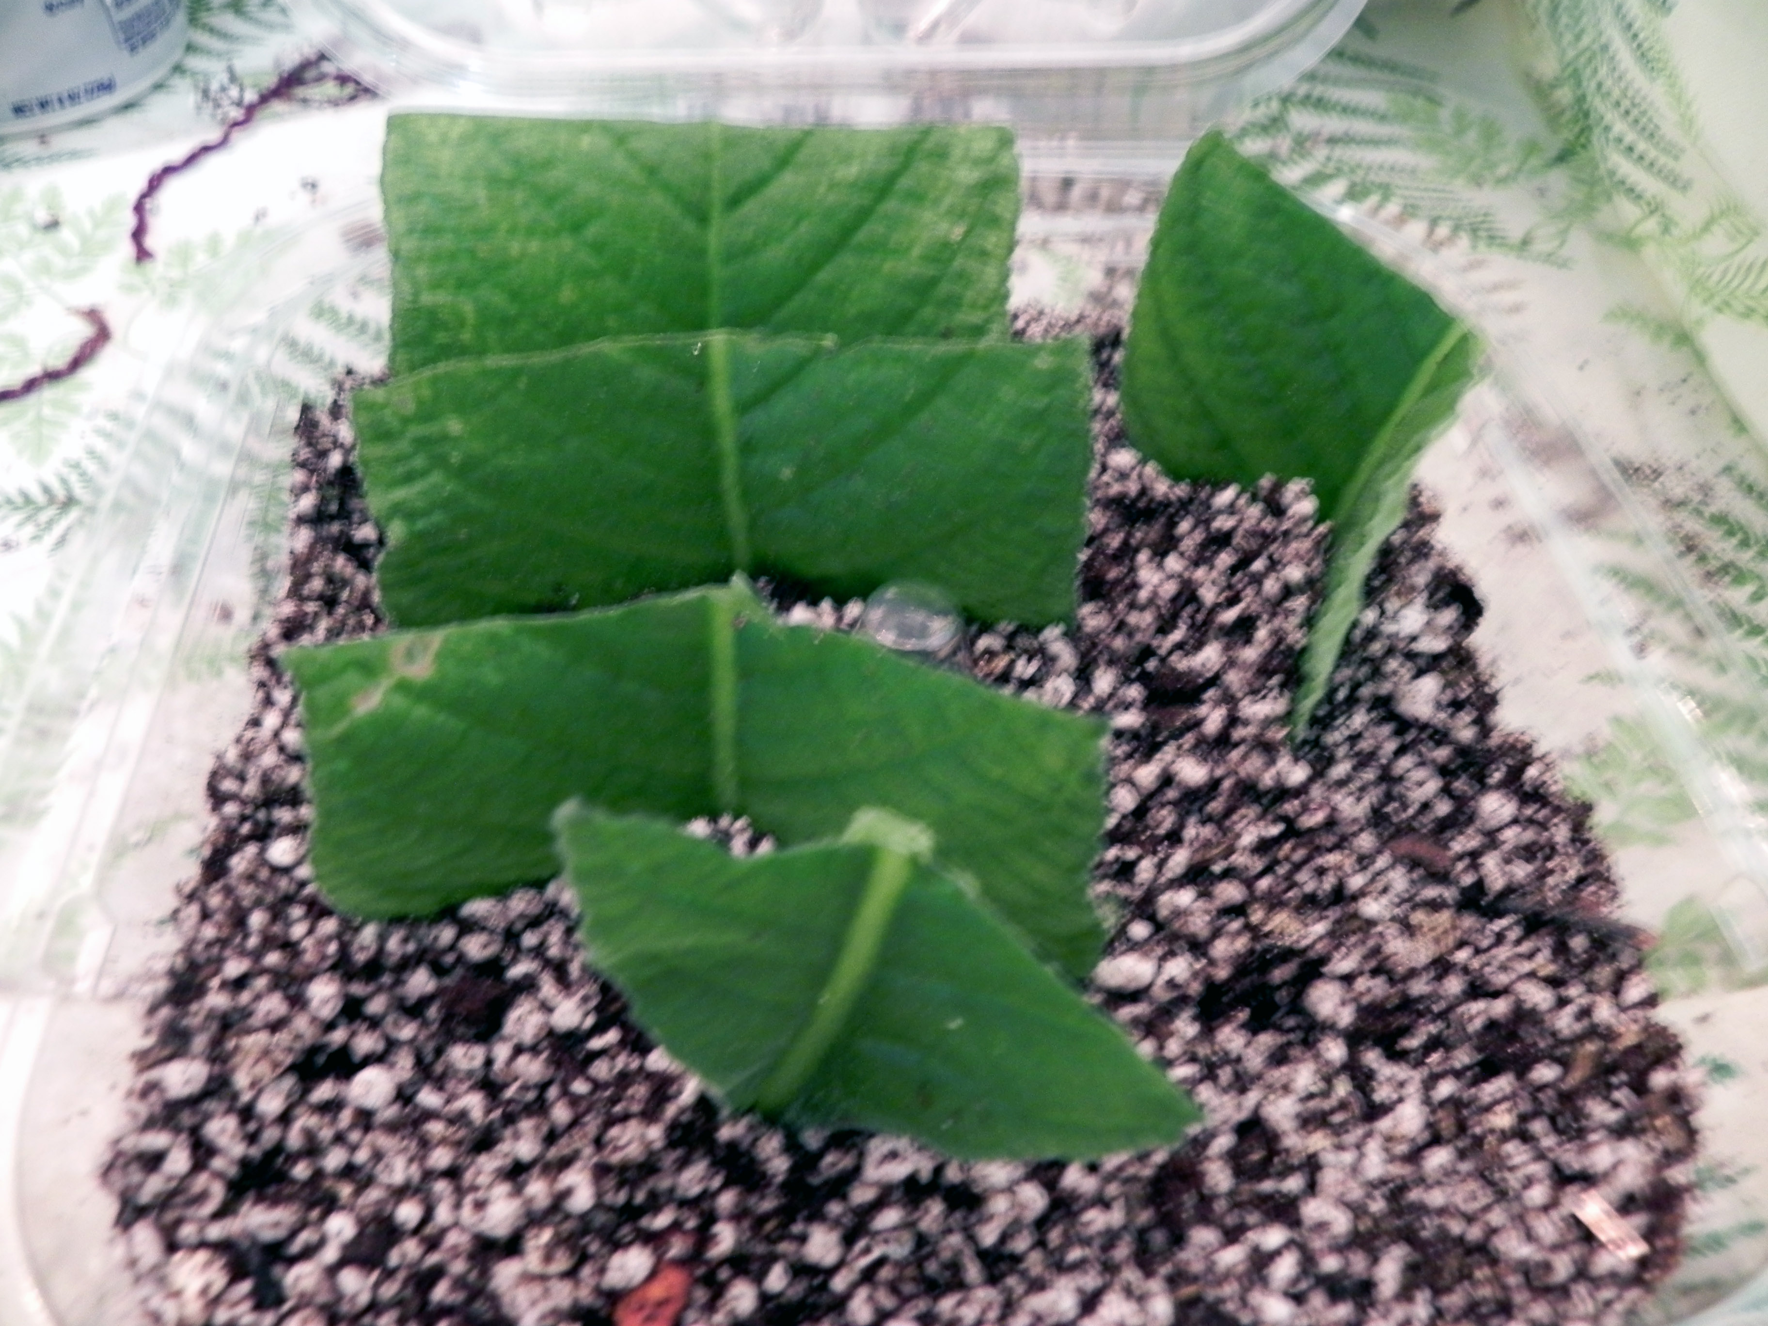
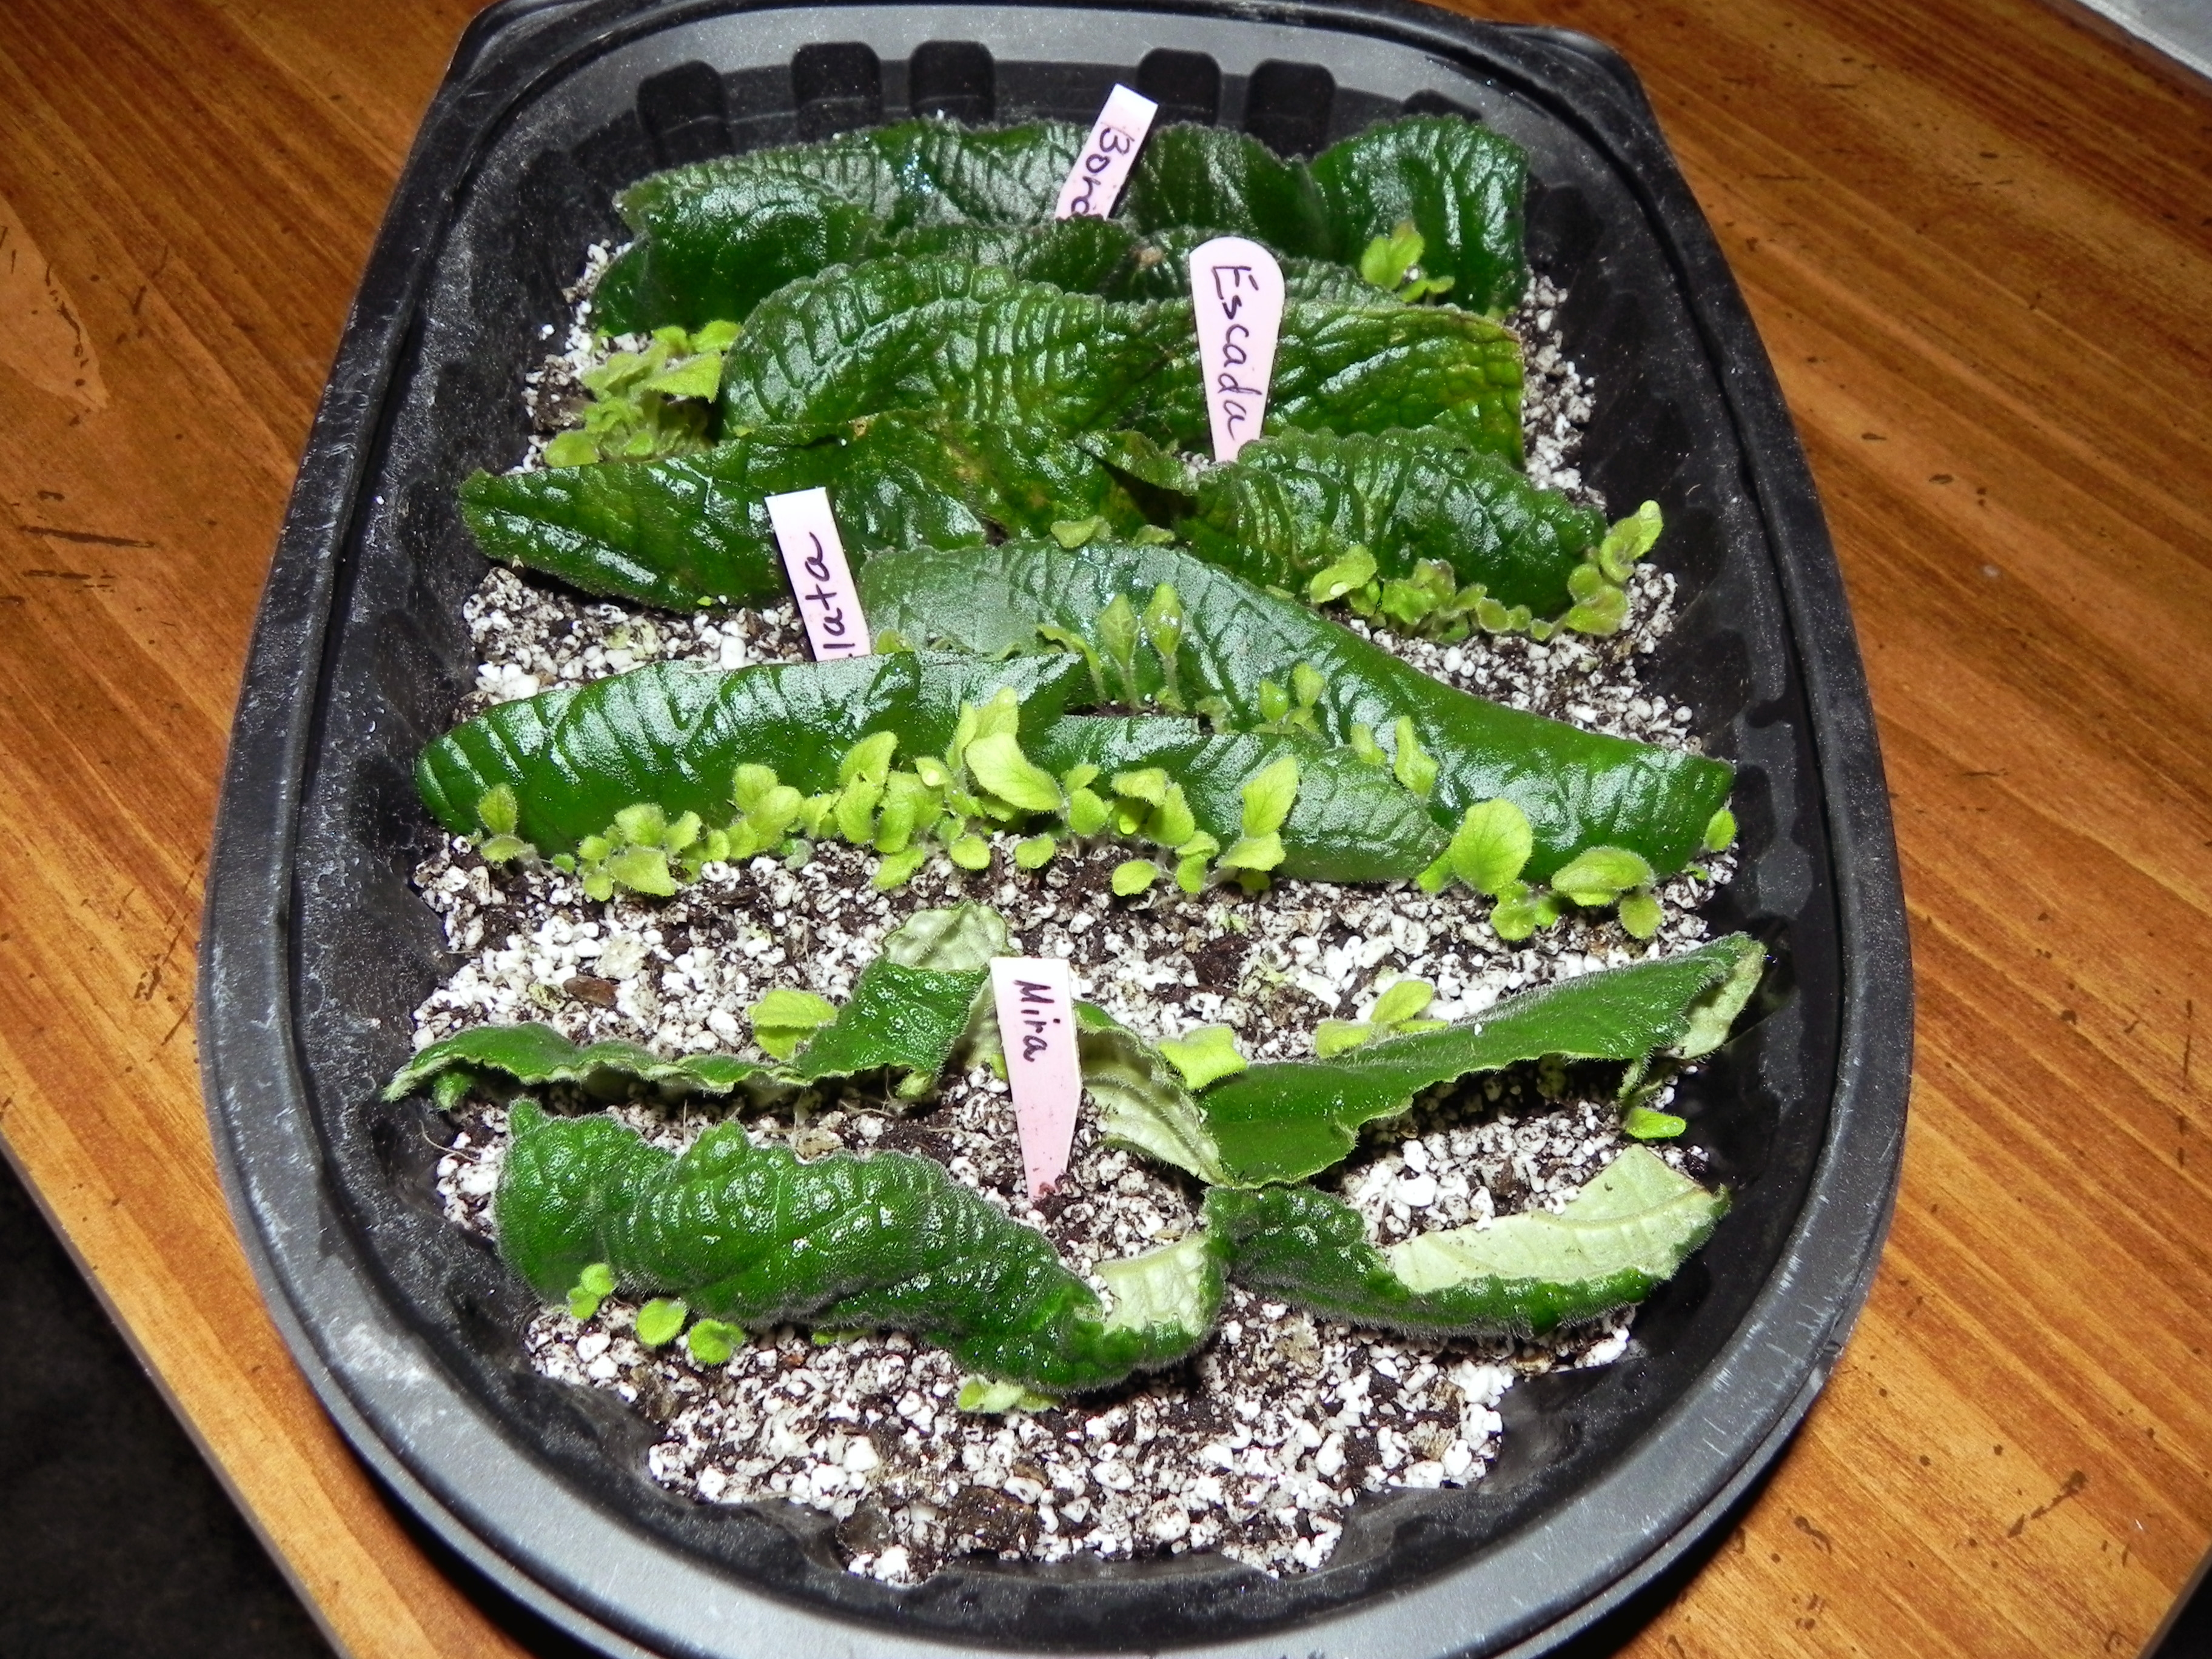
Examples Leaf Cuttings Leaf Sections Mid-rib Method

Slide 9
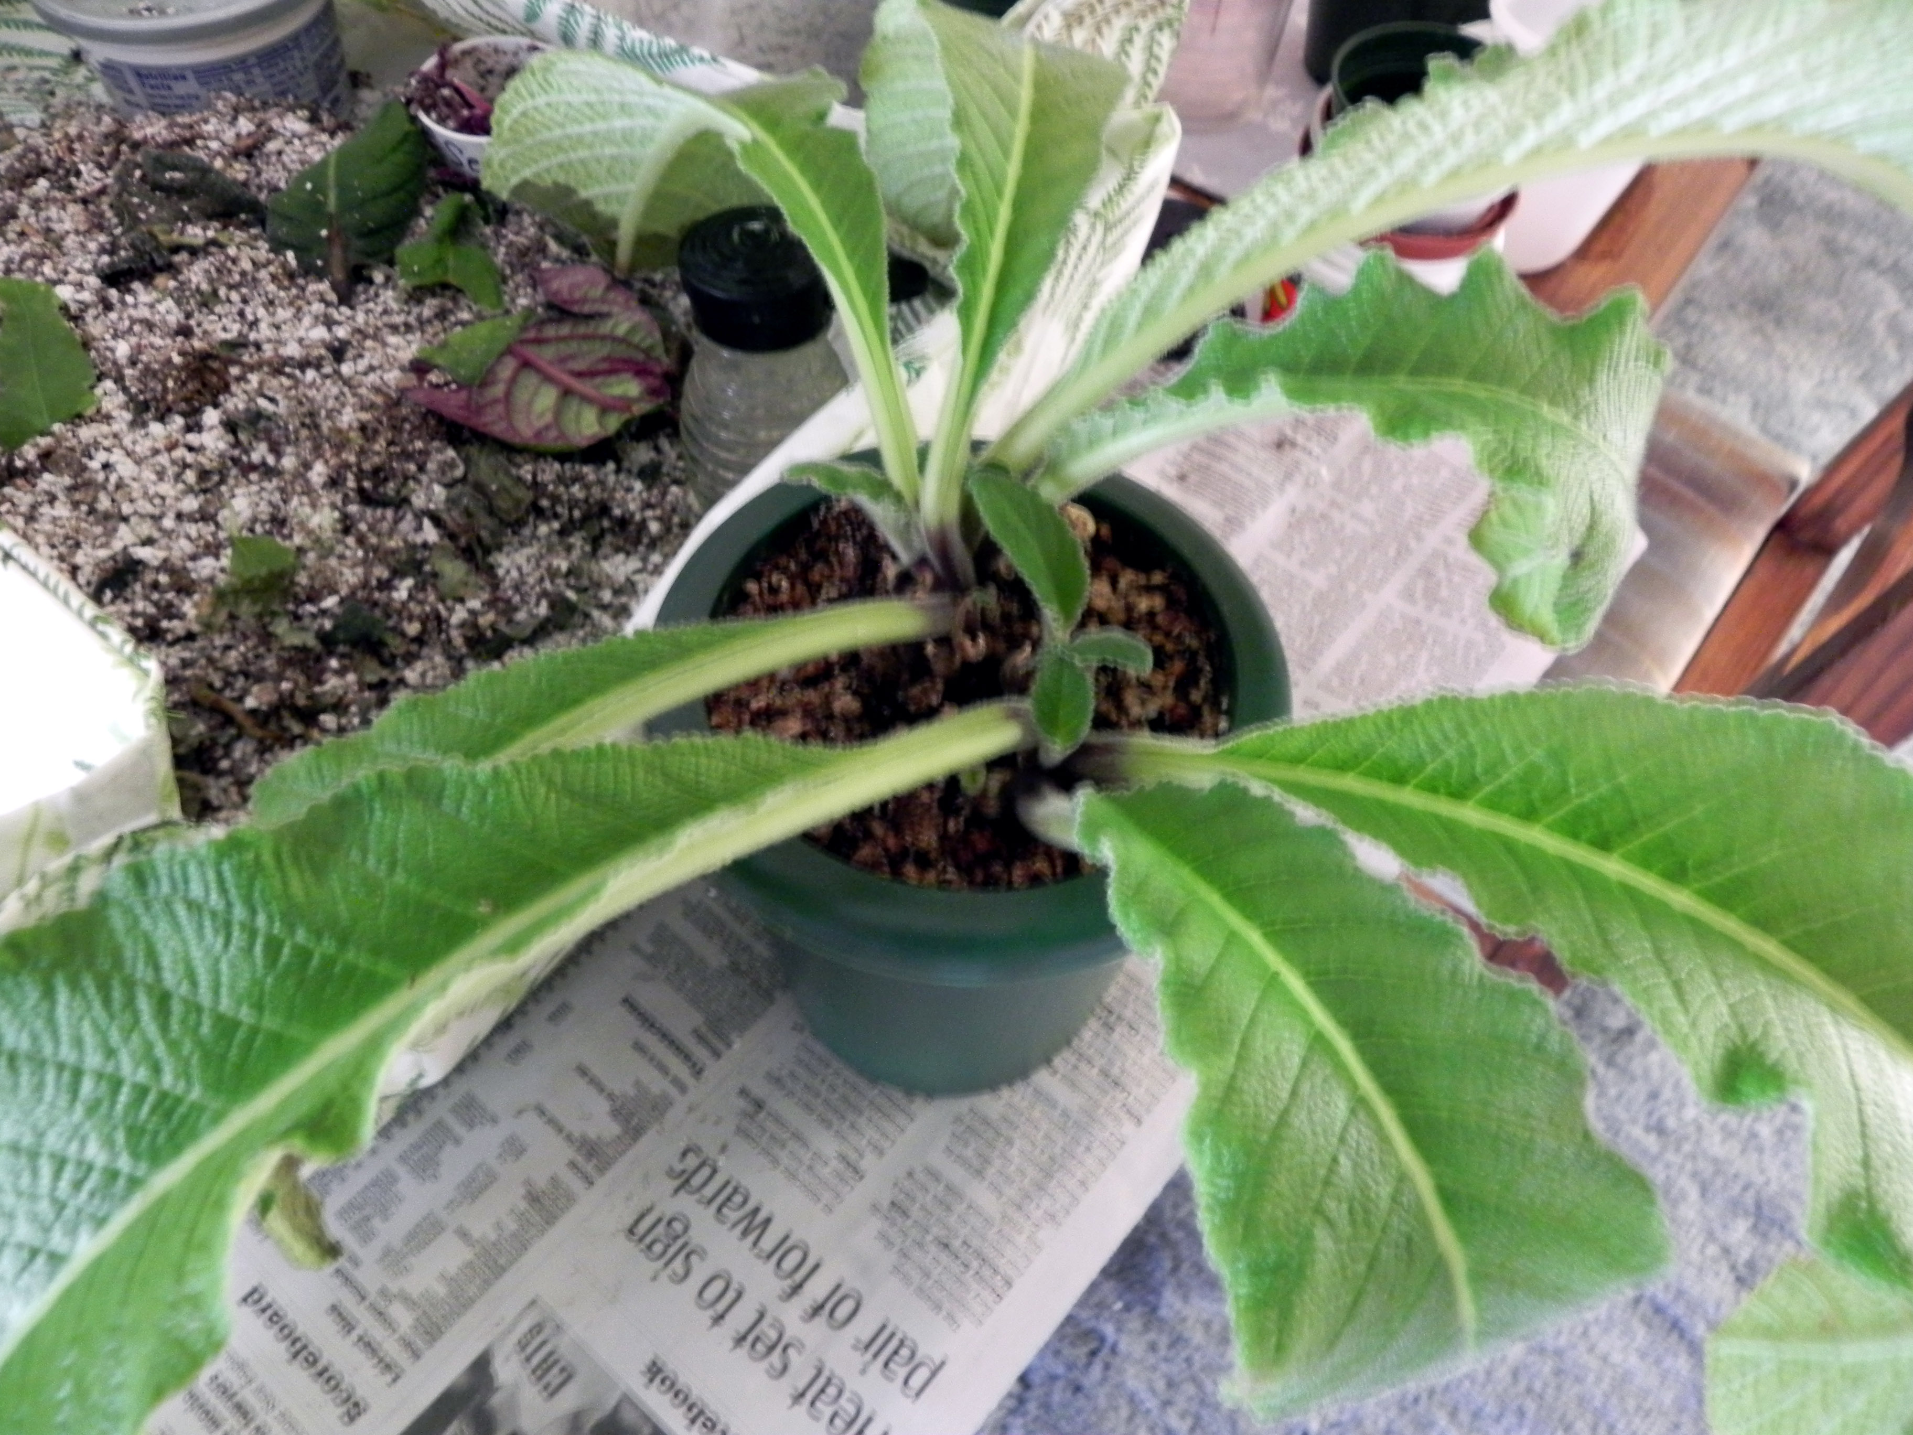
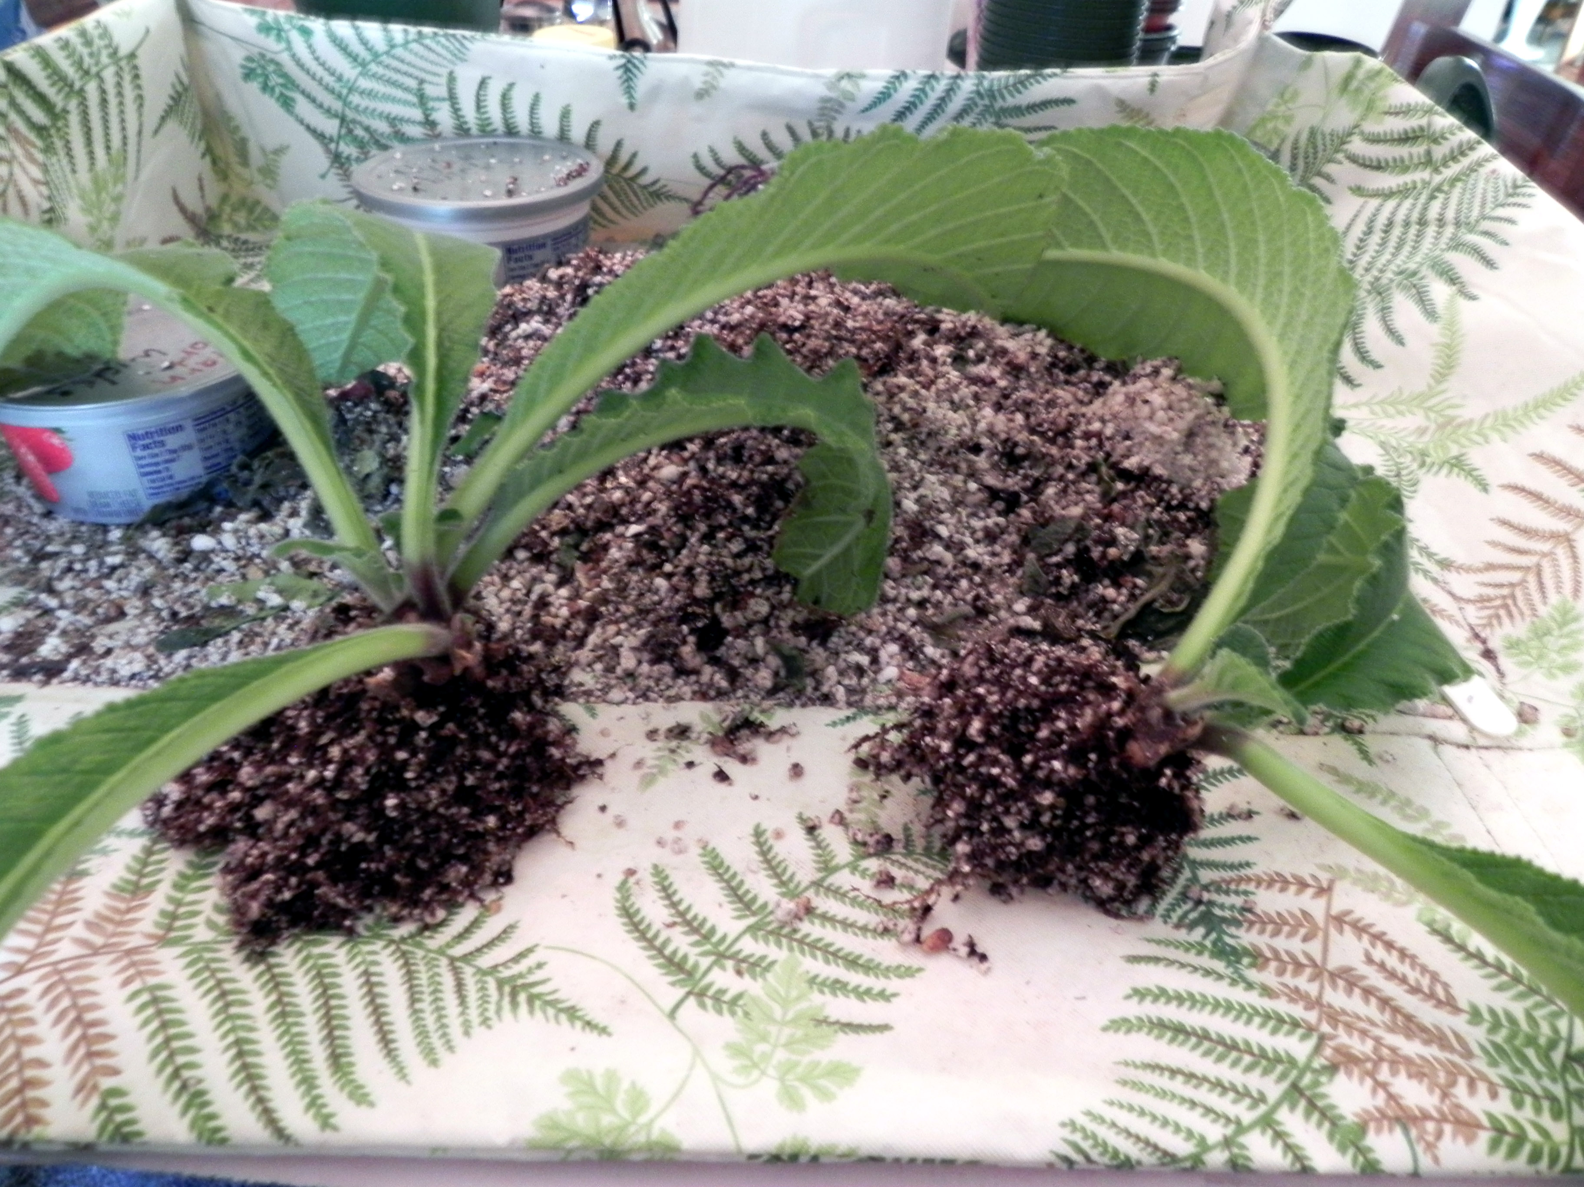
Examples Root Division

Slide 10
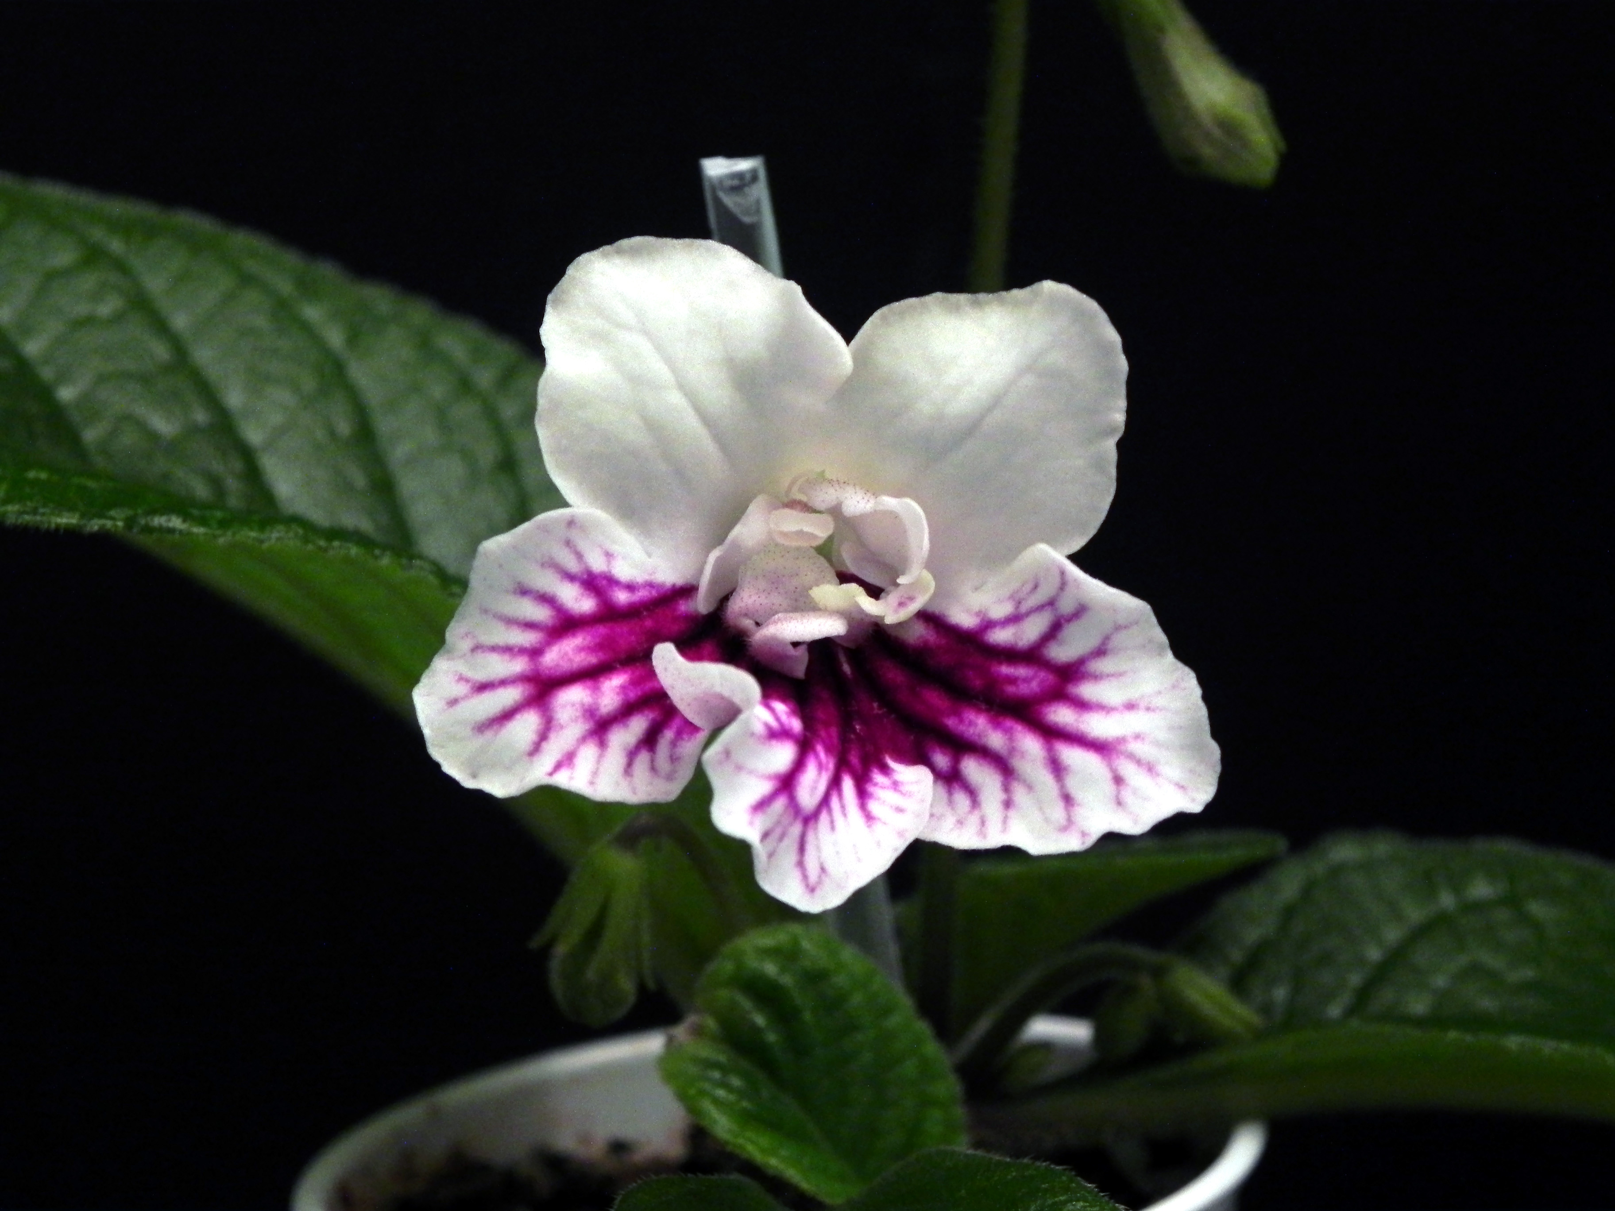
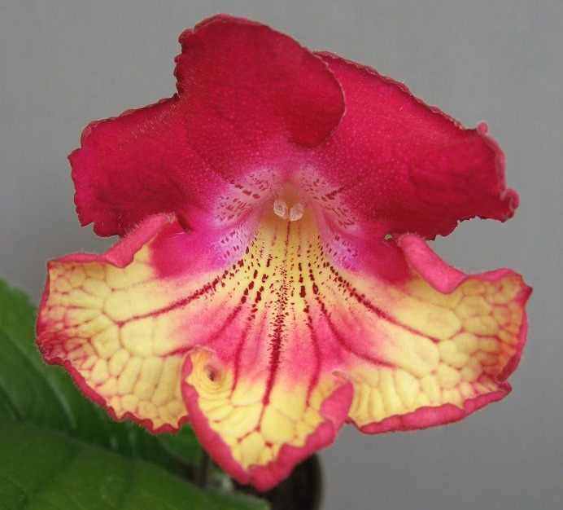
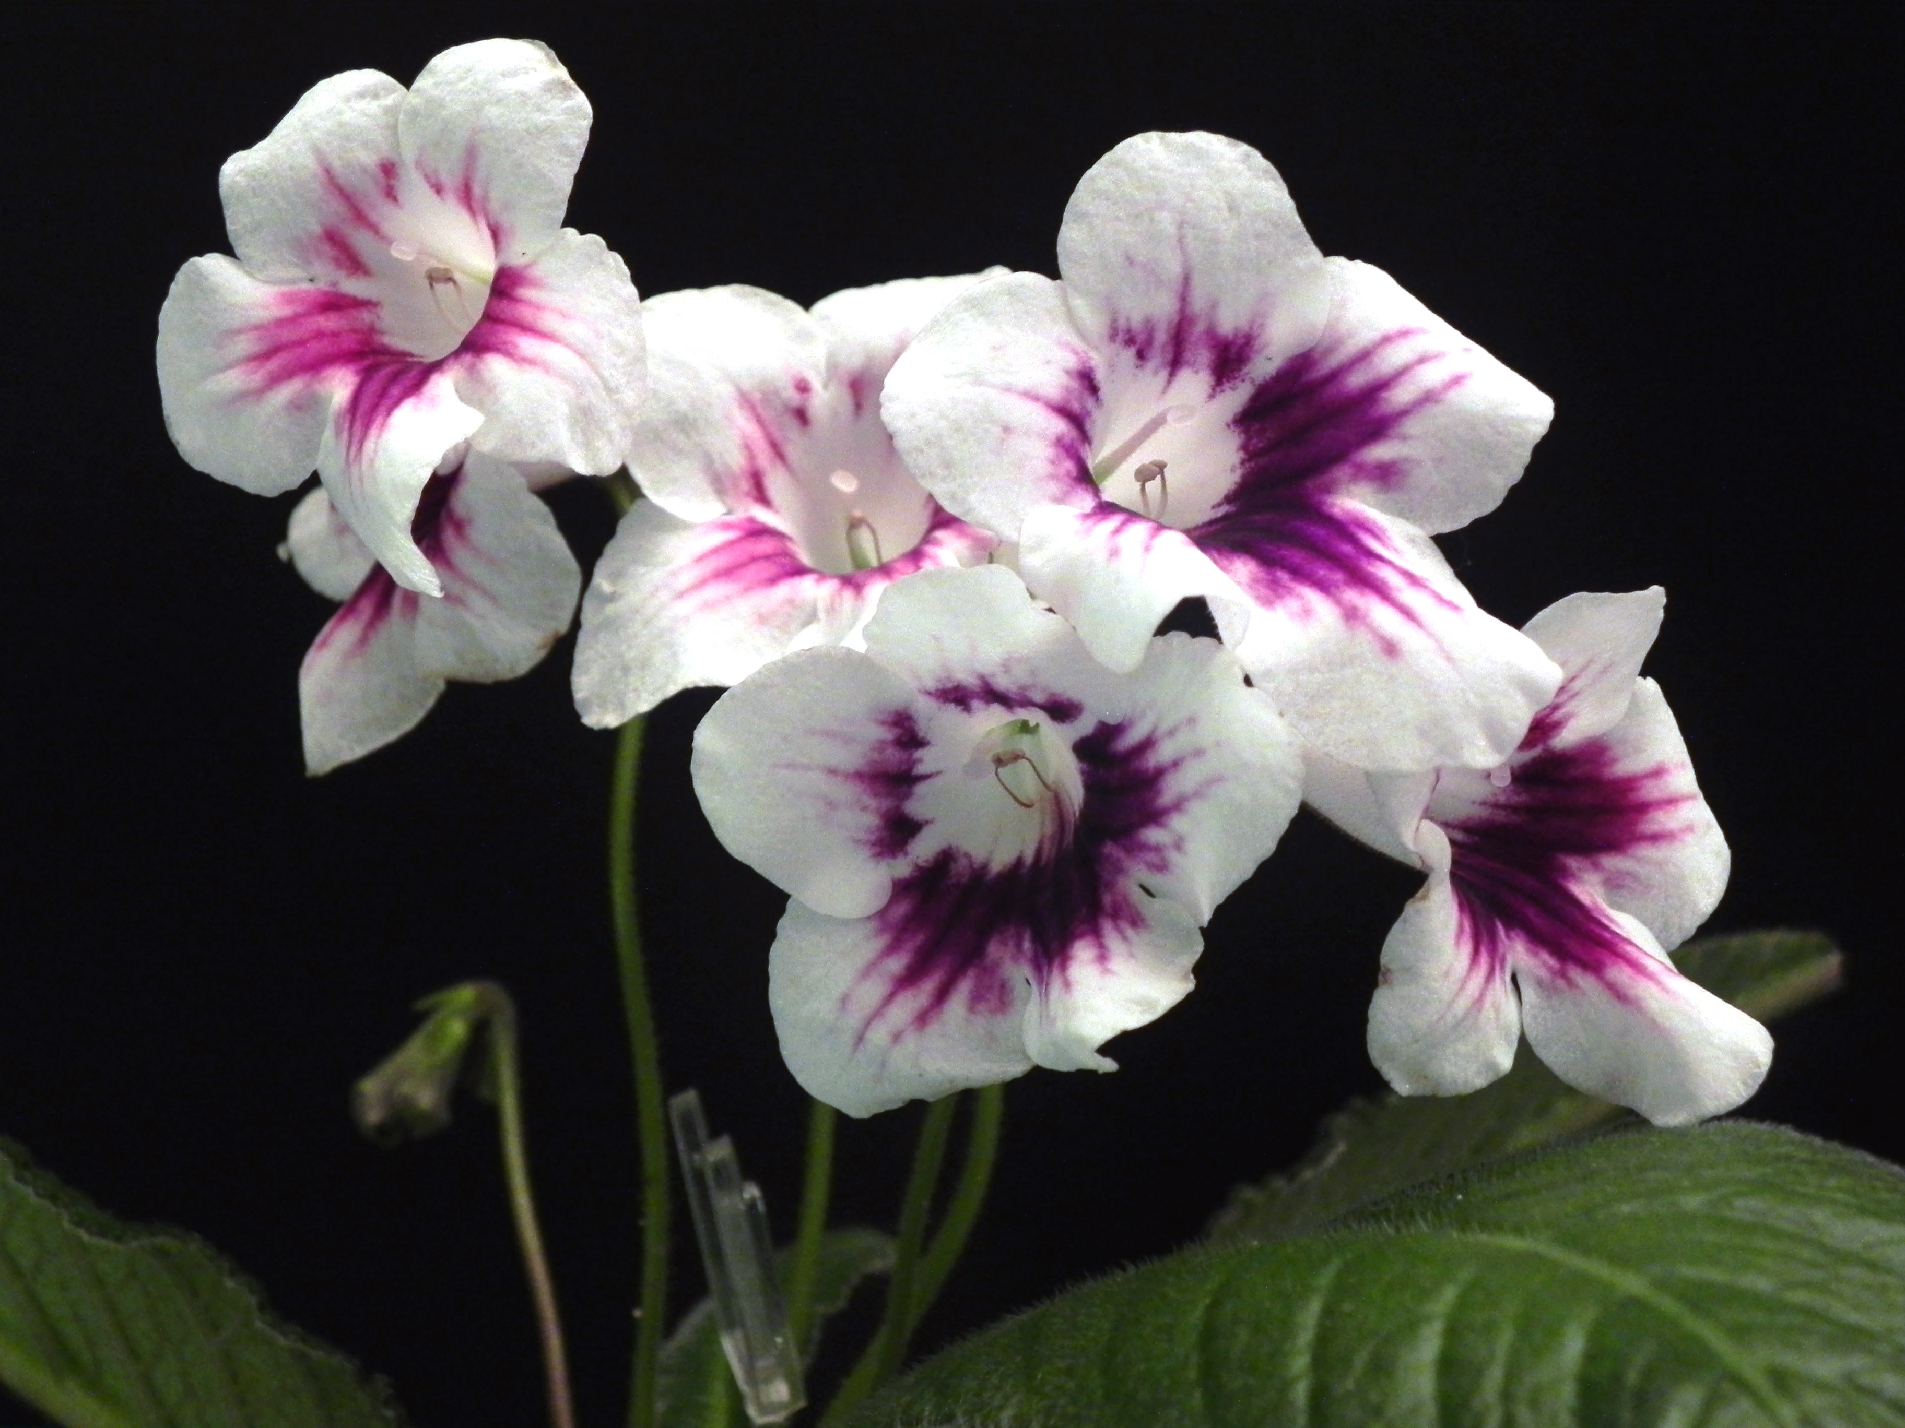
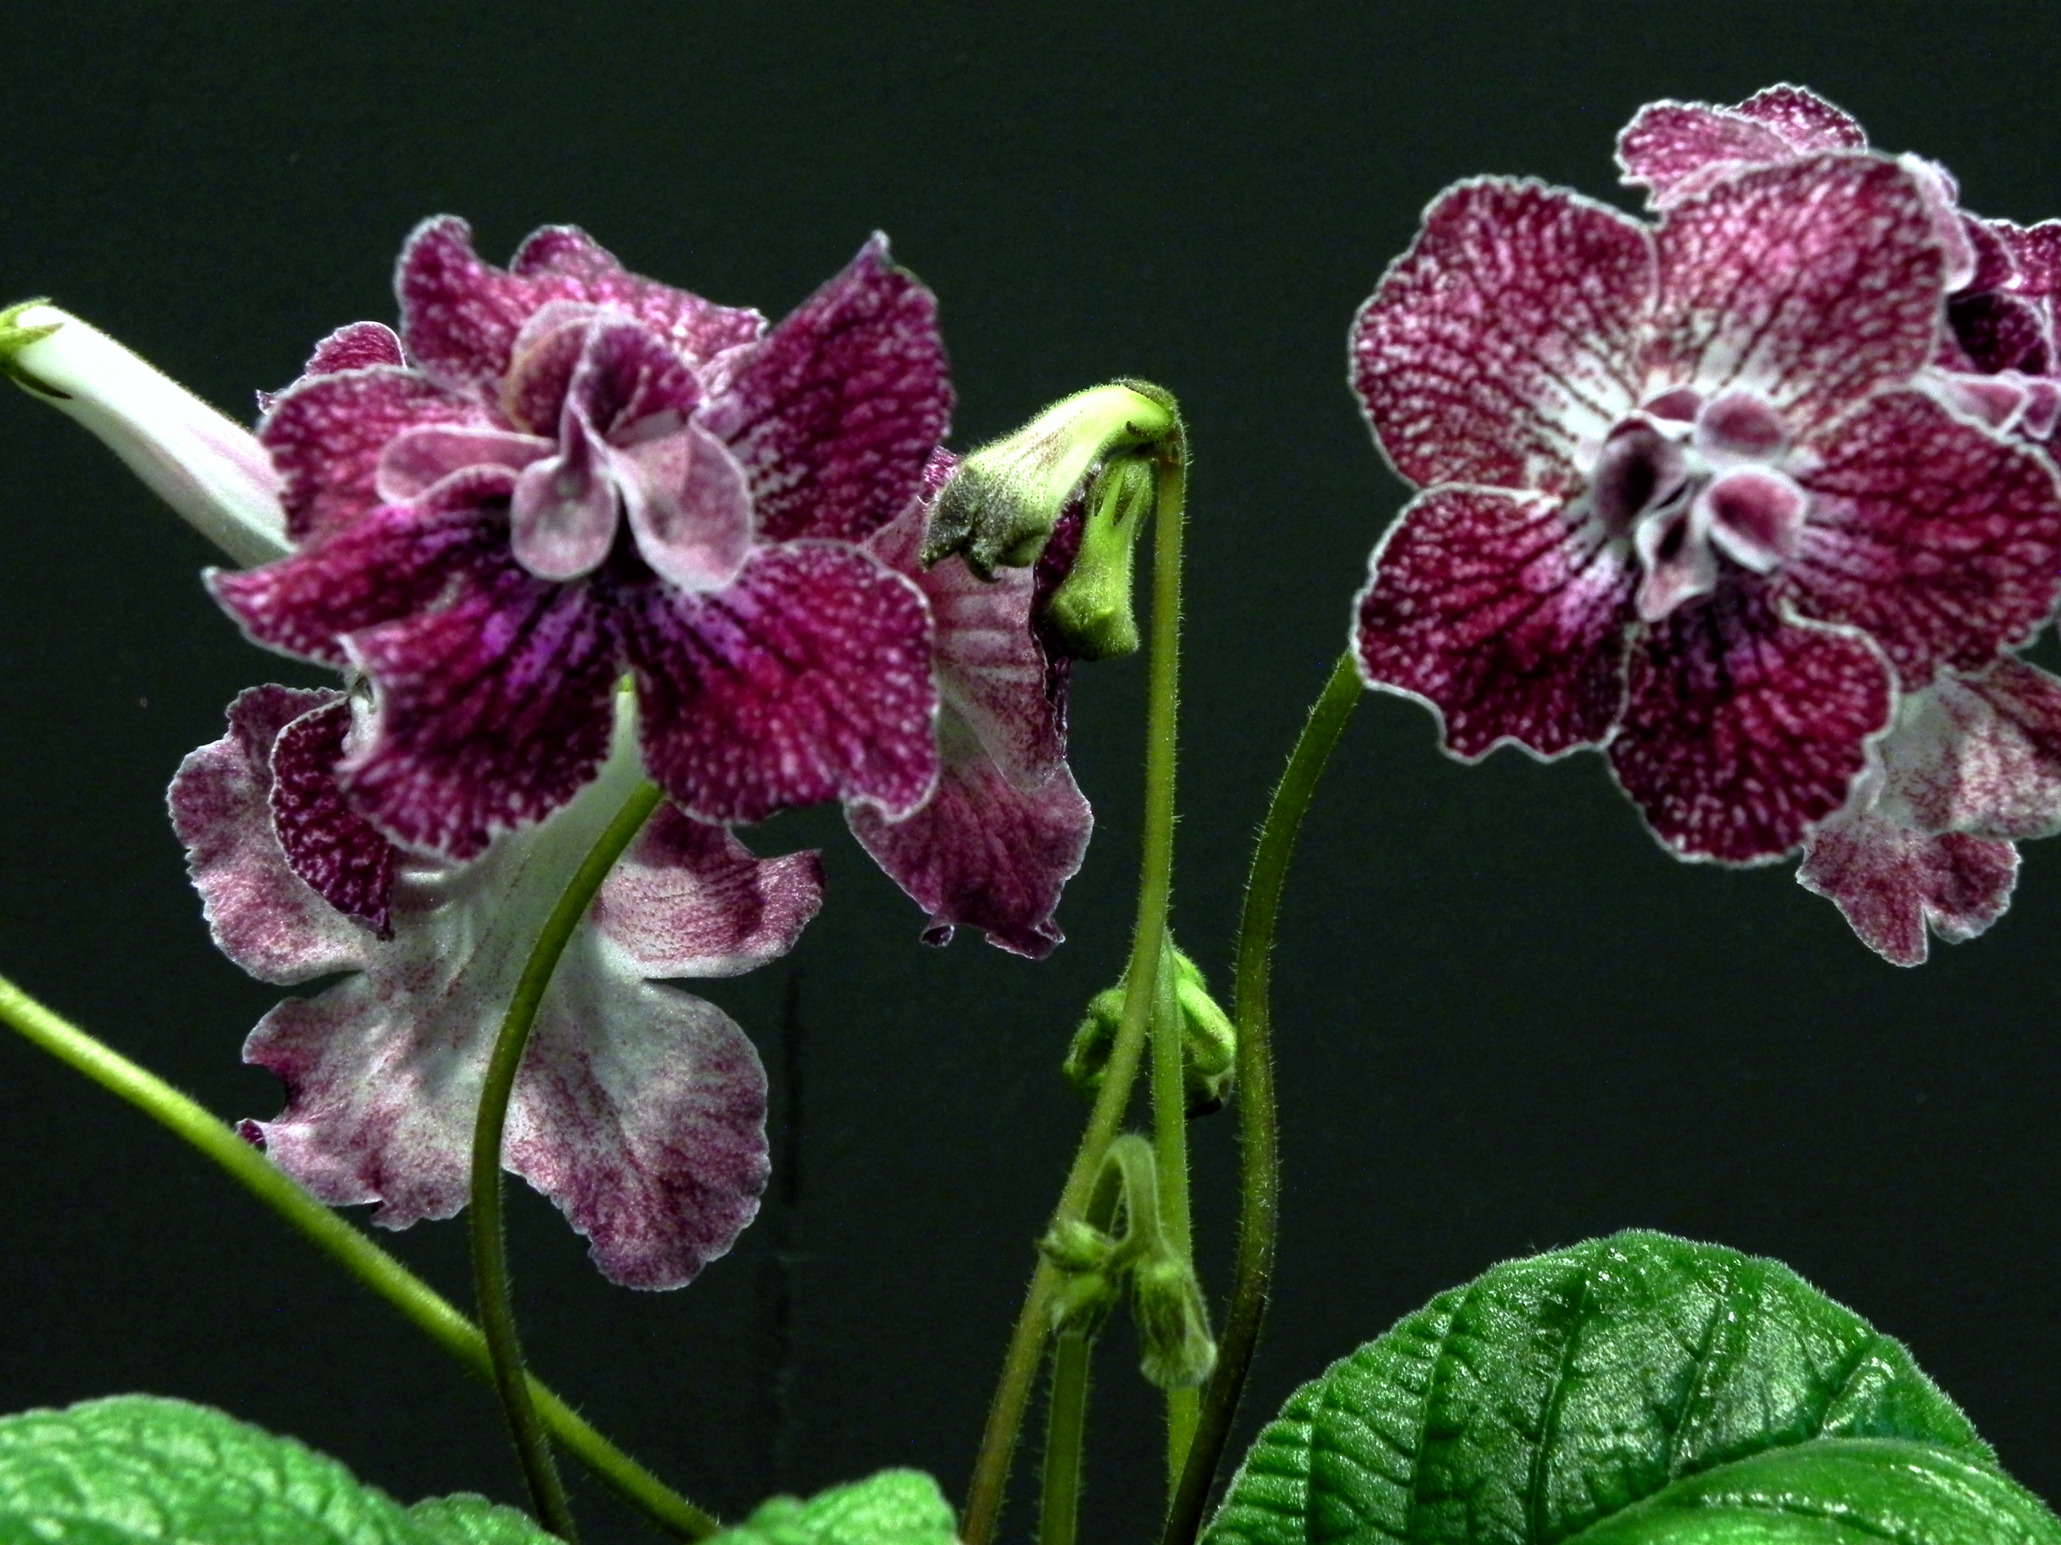
Some DS Varieties

Slide 11
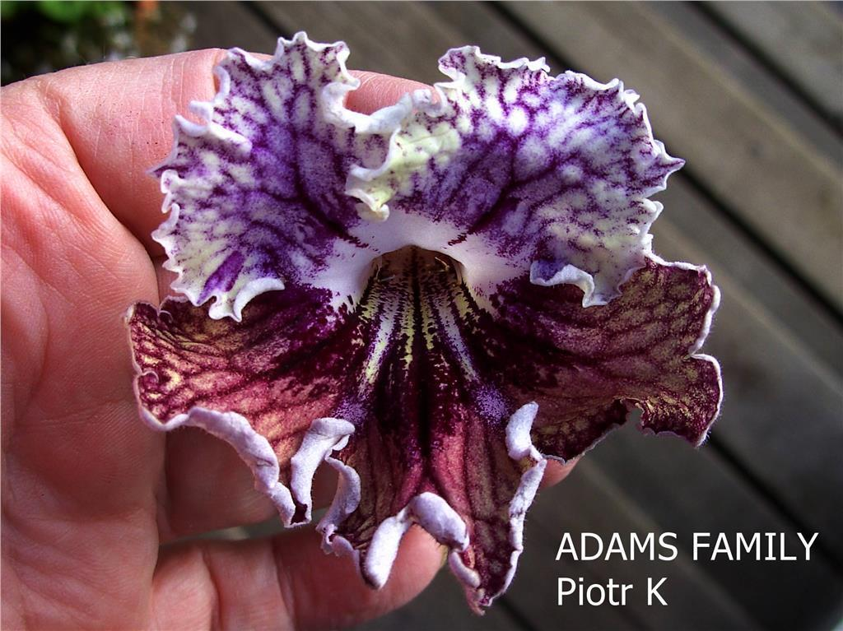
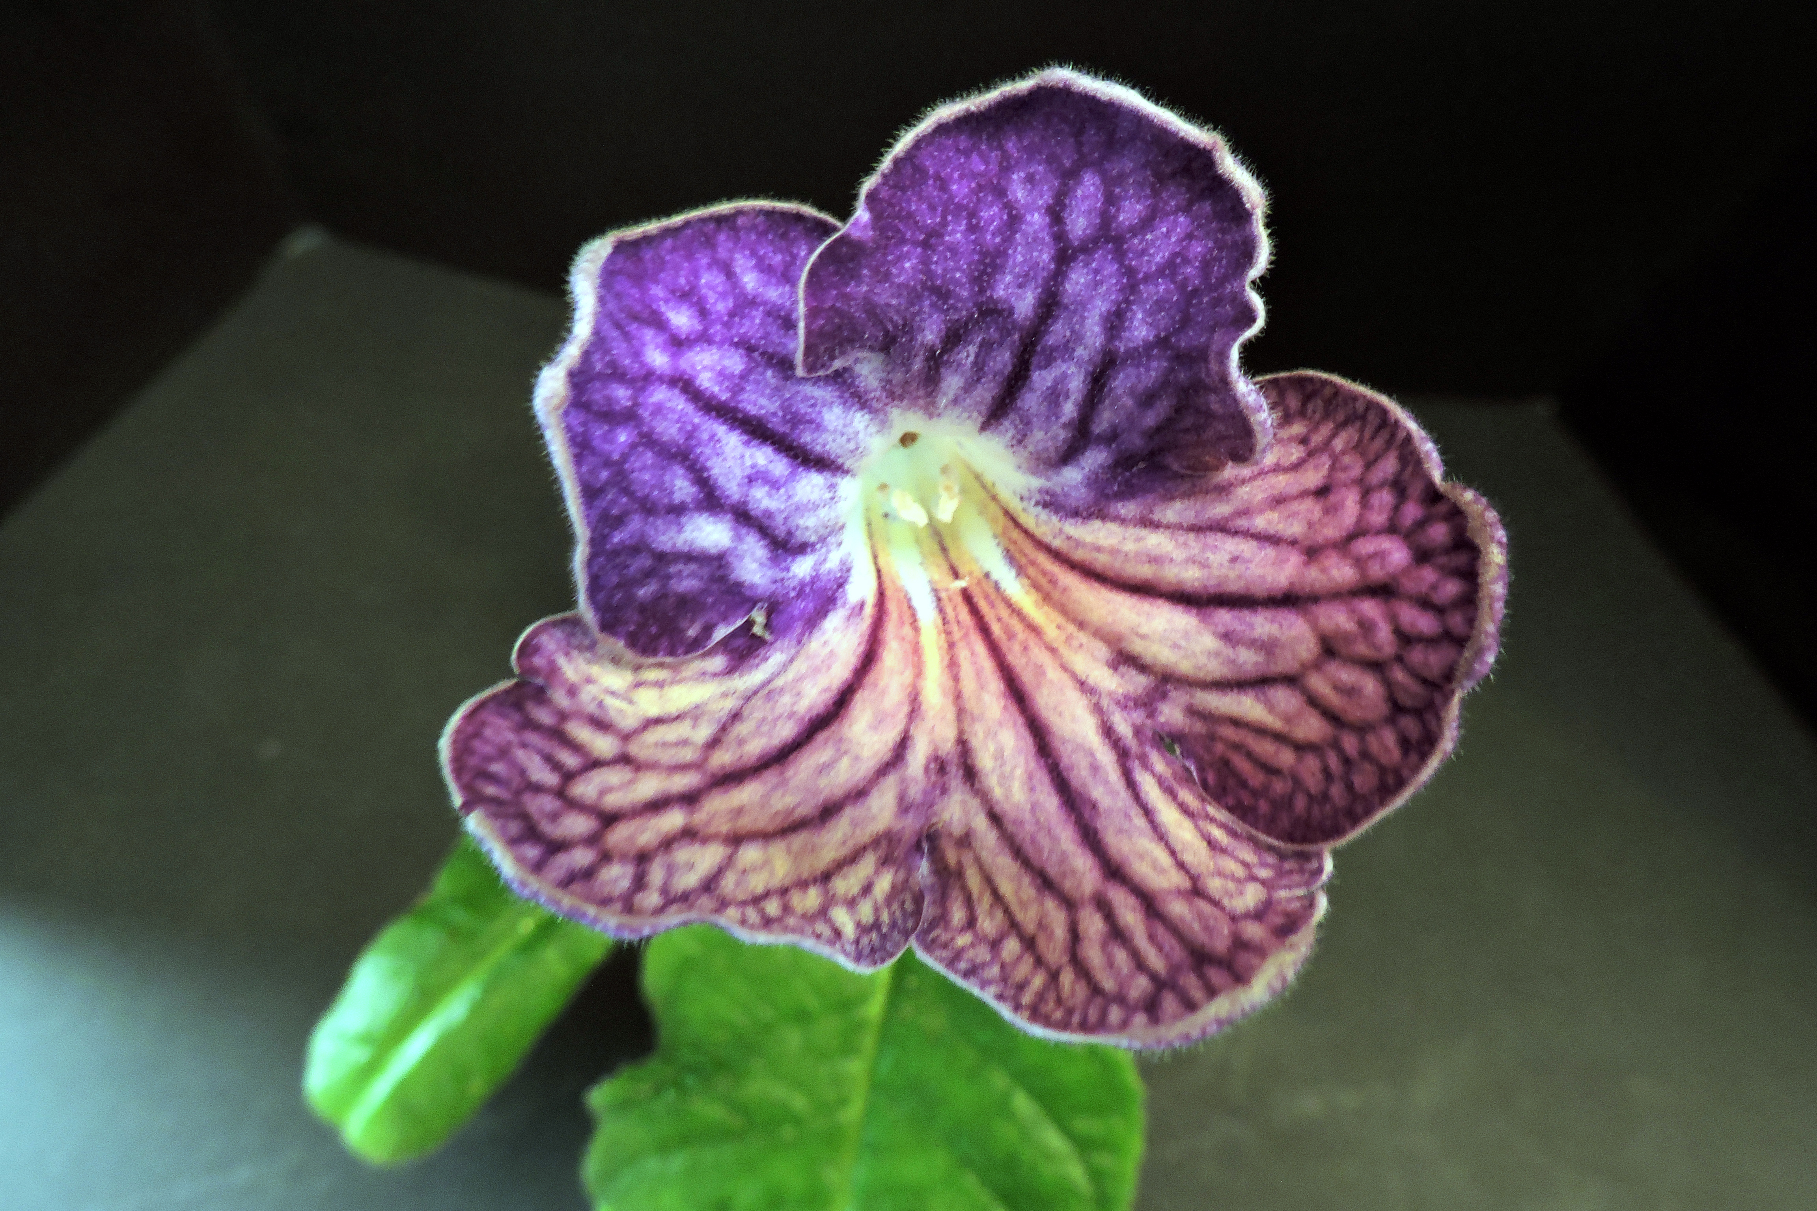
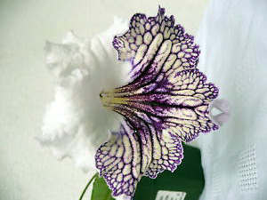
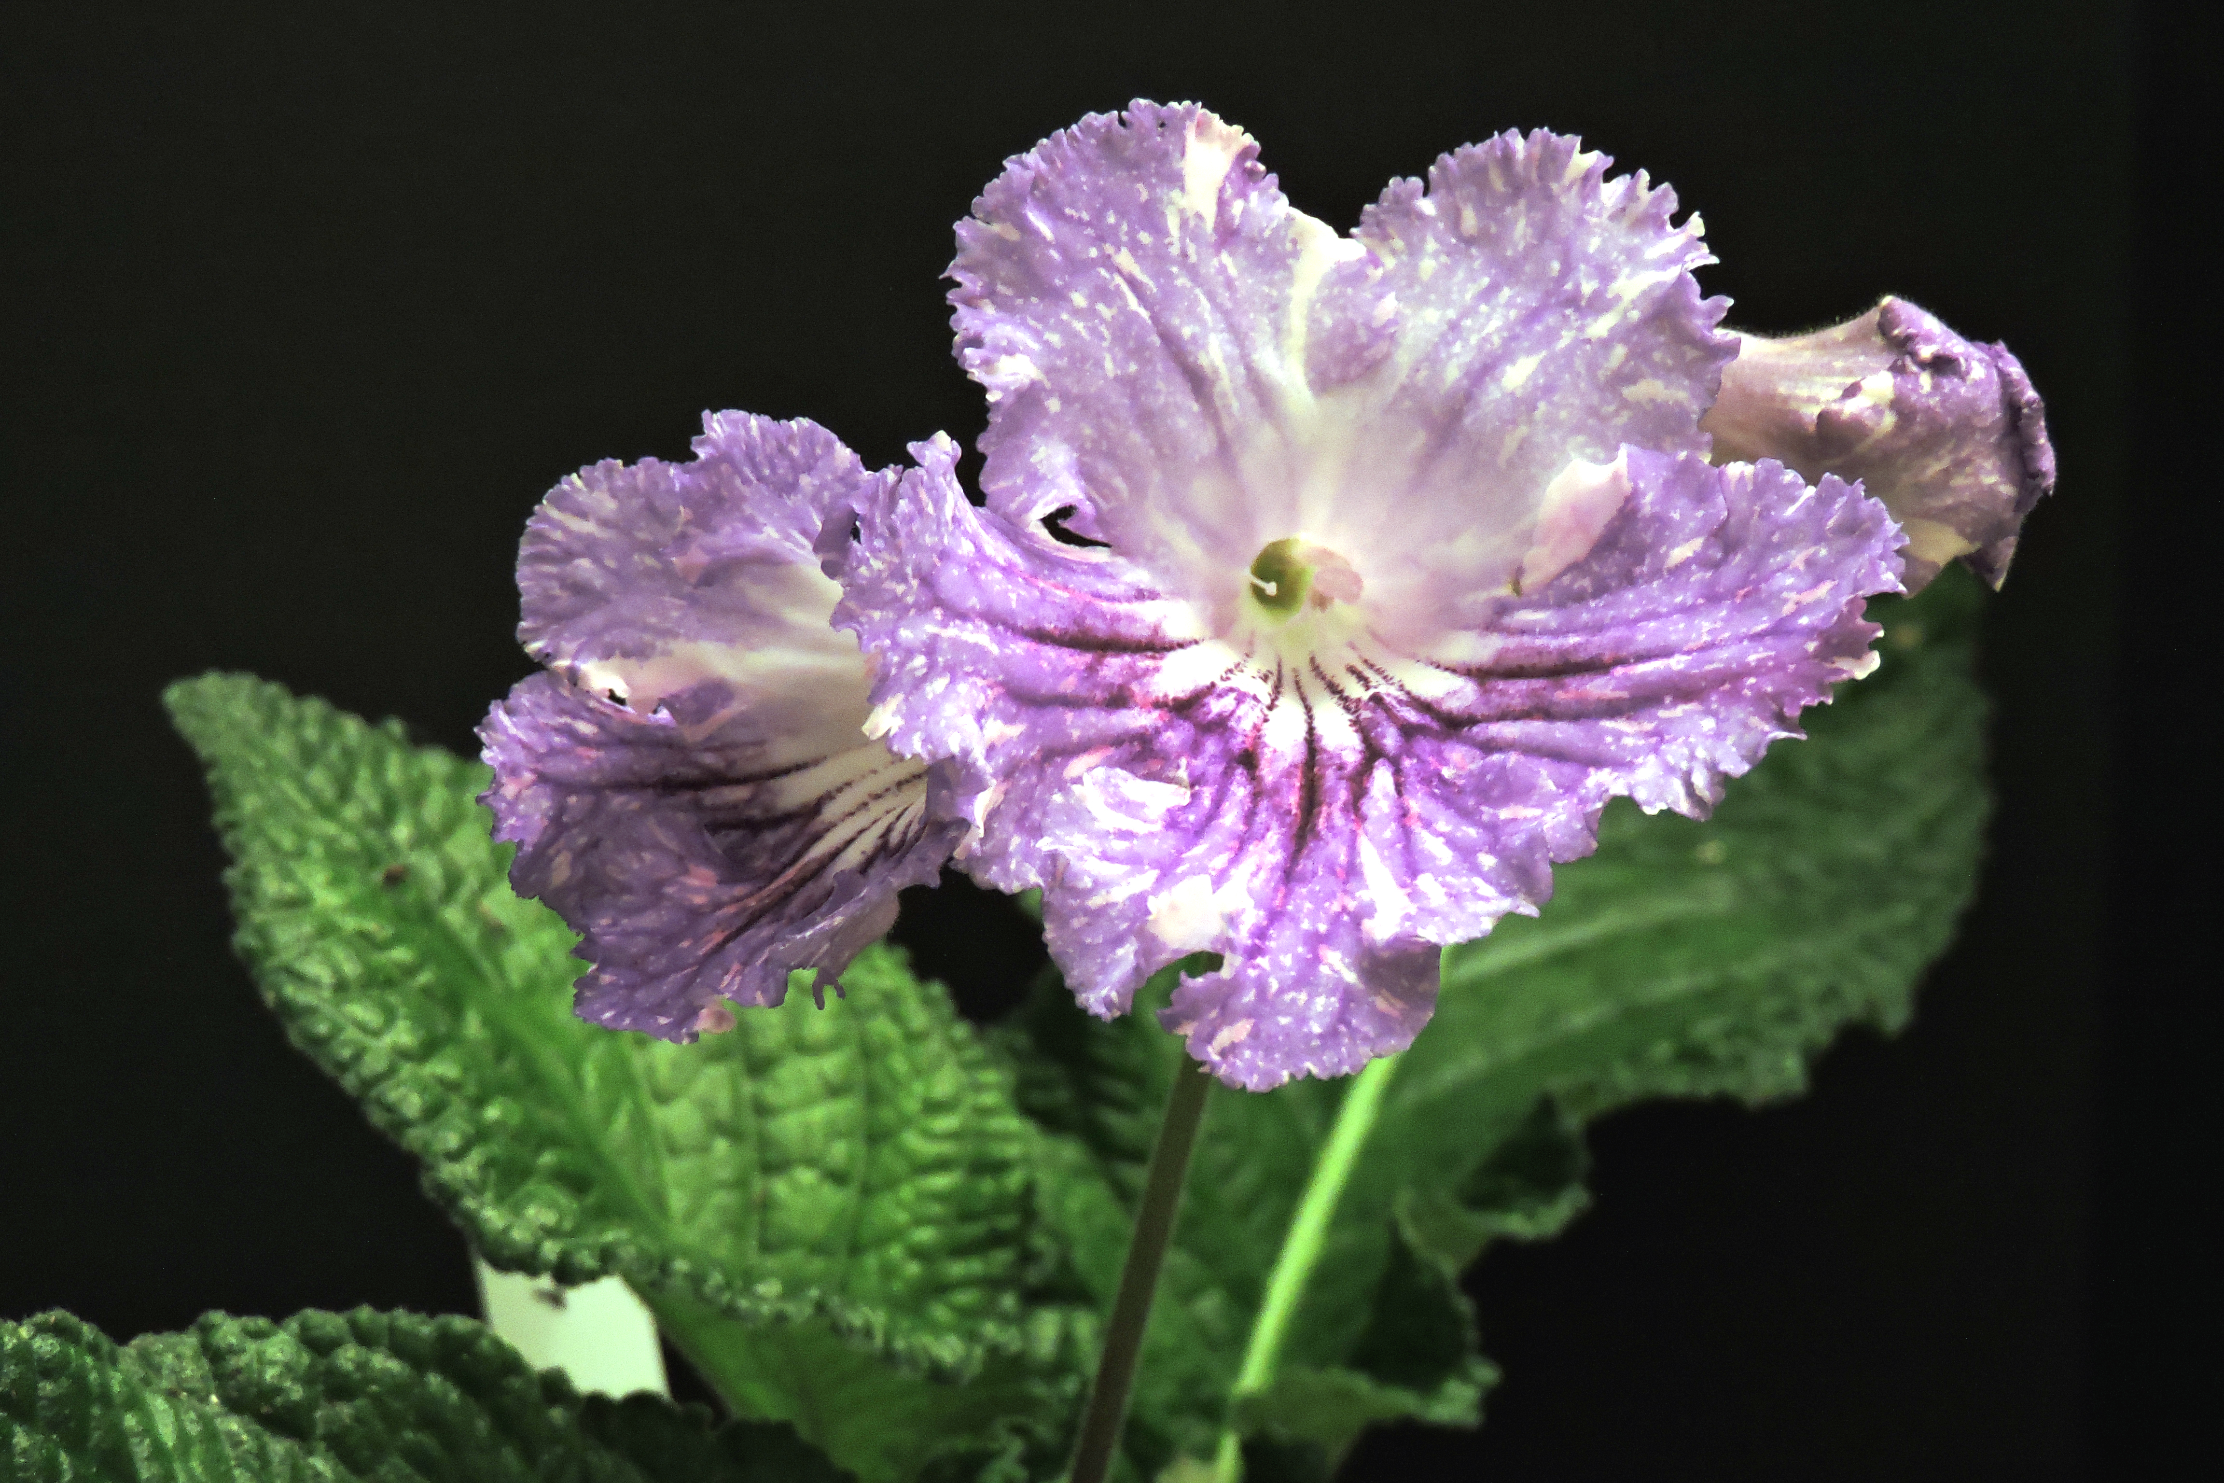
Some Piotr Kleszczynski Varieties
Some Piotr Kleszczynski Varieties
Adam's Family
Denar (Money)
Listy
Eva
HP

Slide 12
Facebook Pages
Strep By Strep
Streptocarpus
Strepaholics
Streptocarpus; tropical plants as houseplants
Bloomin' Jungle African Violets and Streptocarpus
African Violet and Gesneriad Swap
African Violet and Streptocarpus Enthusiasts

Slide 13
Helpful Links
Streptocarpus-info.com
Gloriousgesneriads.org.uk
Bloominjungle.org
Streptocarpus-dimetris.com
Worldofstreps.com
www.dibleys.com/strep.htm

