Slide 1
Streptocarpus
‘Falling Stars’

Slide 2
PROJECT PLANT 2024
Project Plants allow members to learn about gesneriads and for the club to learn about various growing conditions.
We would like everyone to bring your plant to the annual show in March, so we can see to the differences in the plants and the impacts on how you grew your plant under your conditions.
I am here to help and answer questions, as well as the Joann and the club.

Slide 3
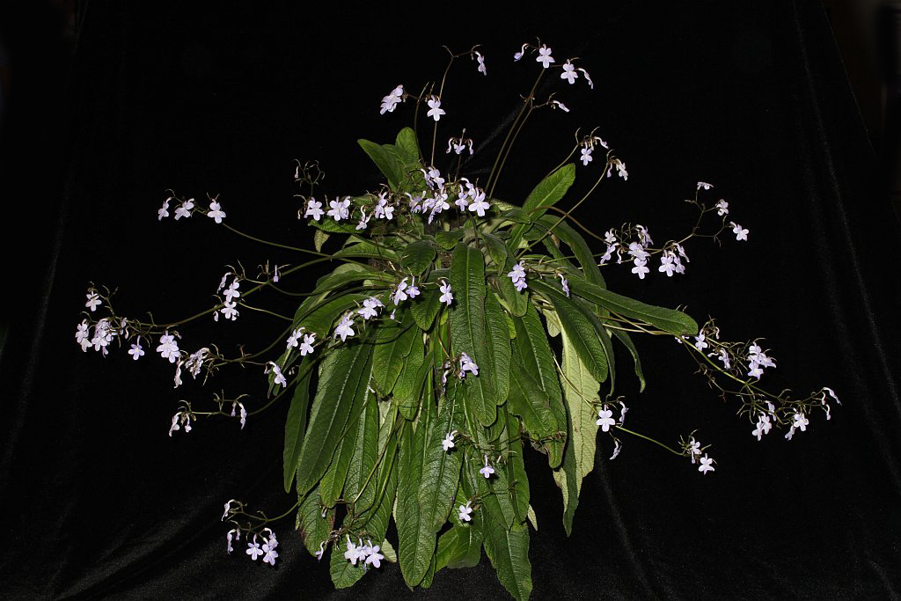
Streptocarpus johannis
Commonly known as Port St. Johns, endemic to South Africa from Eastern Cape to KwaZulu-Natal
growing naturally in forests growing in soil banks or on rocks from the coast to altitudes of 1650m.
The species has much variation depending on its natural location. Typically it is whitish to pale violet, and up to 12 flowers per inflorescence, flat-faced summer flowers, and soft green leaves.

Slide 4
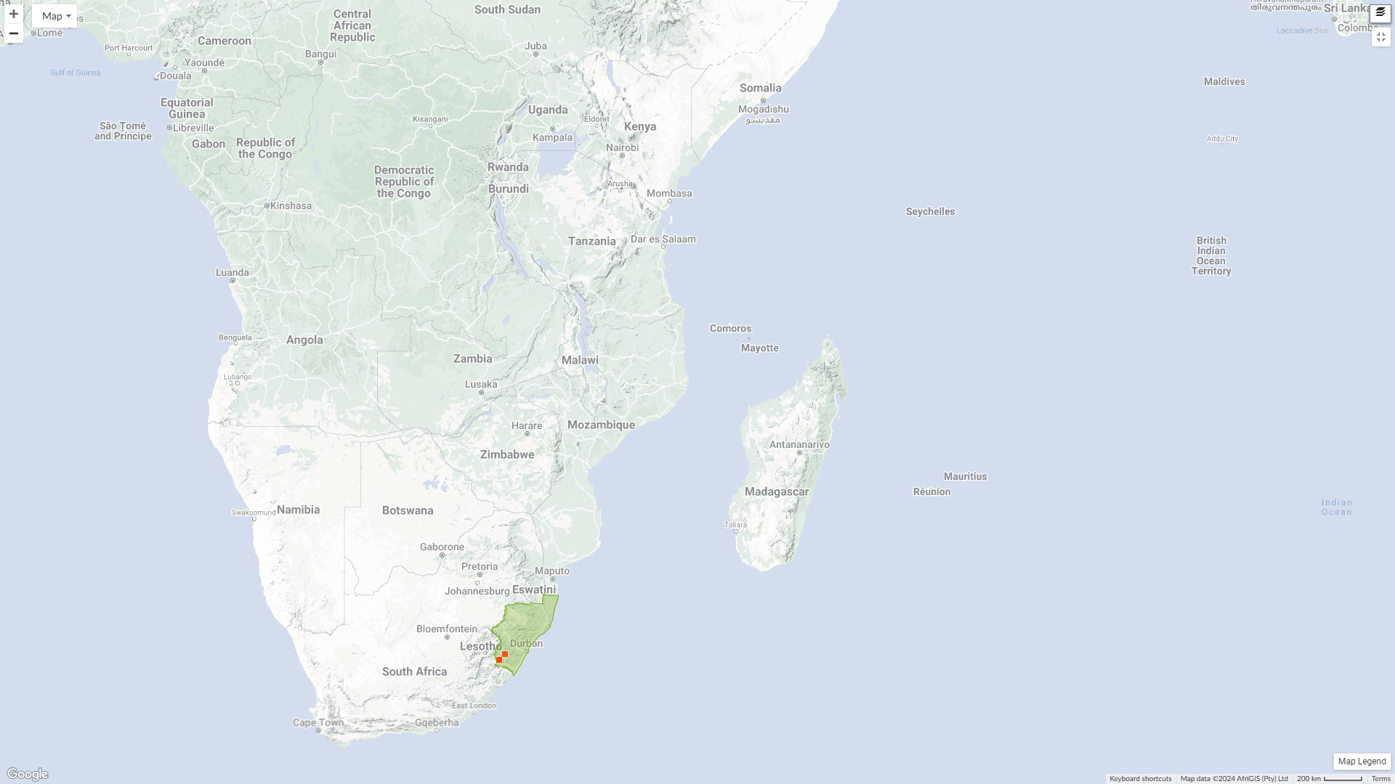

Slide 5
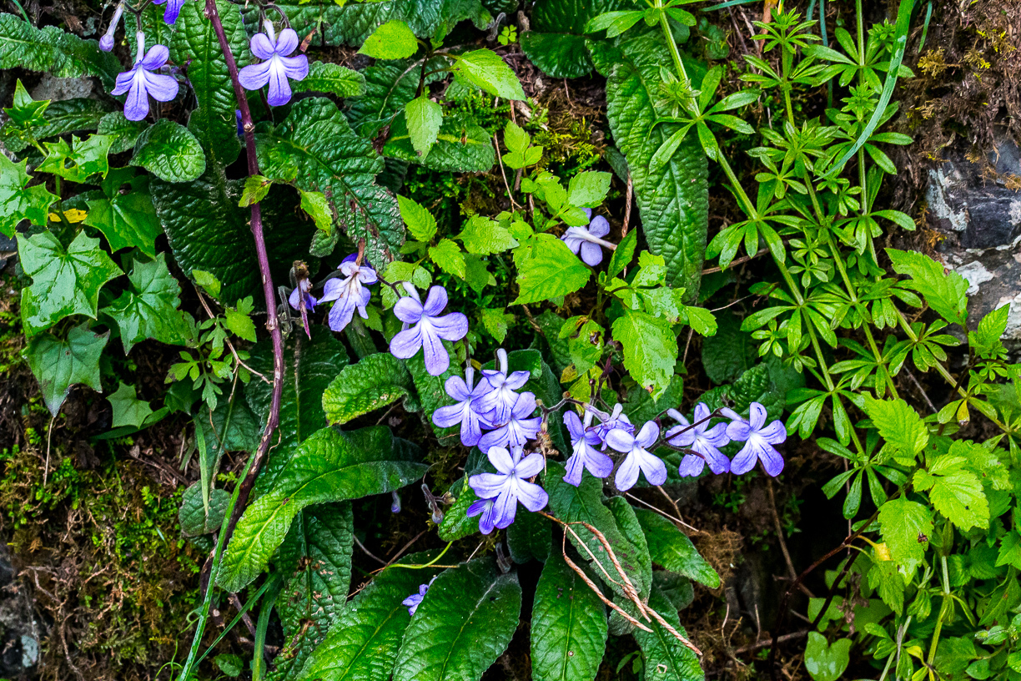

Slide 6
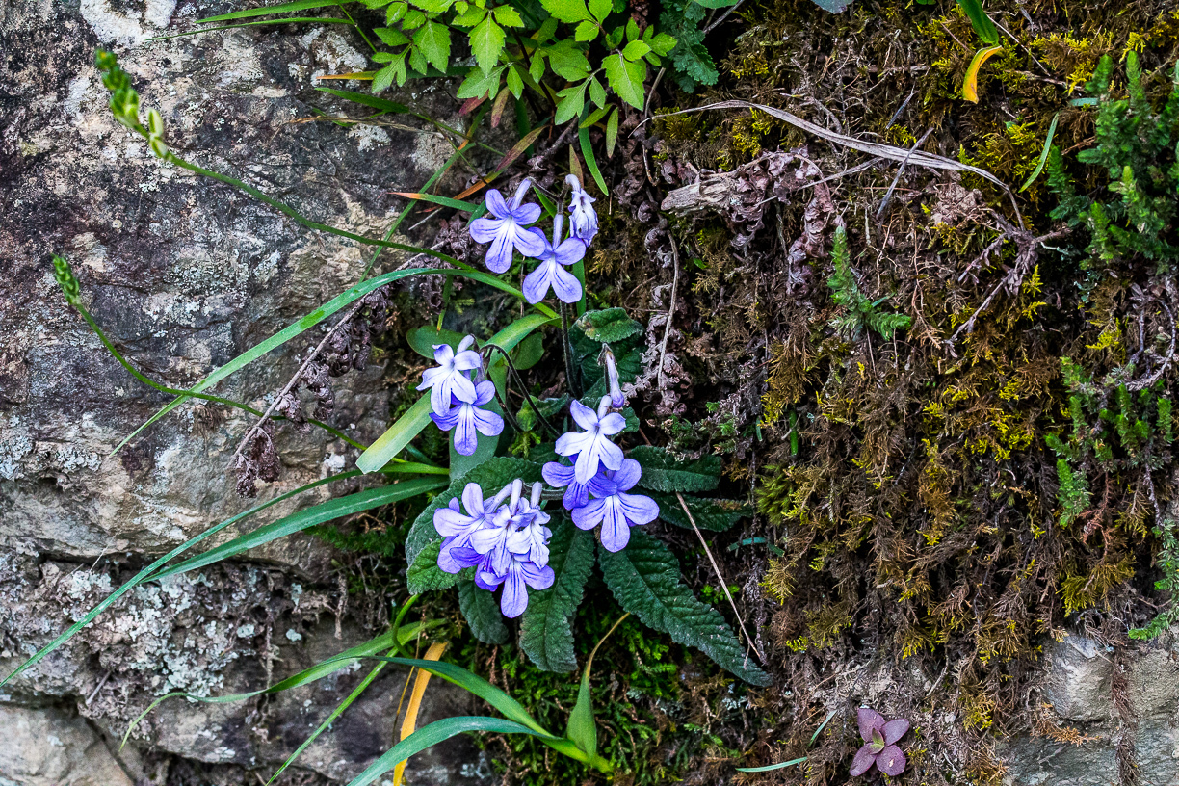

Slide 7
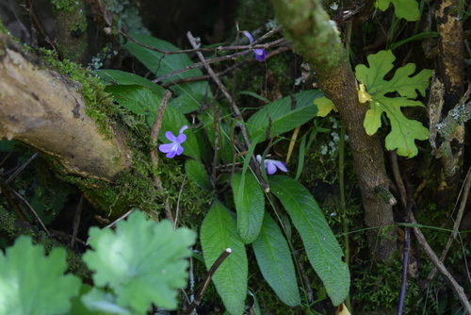

Slide 8
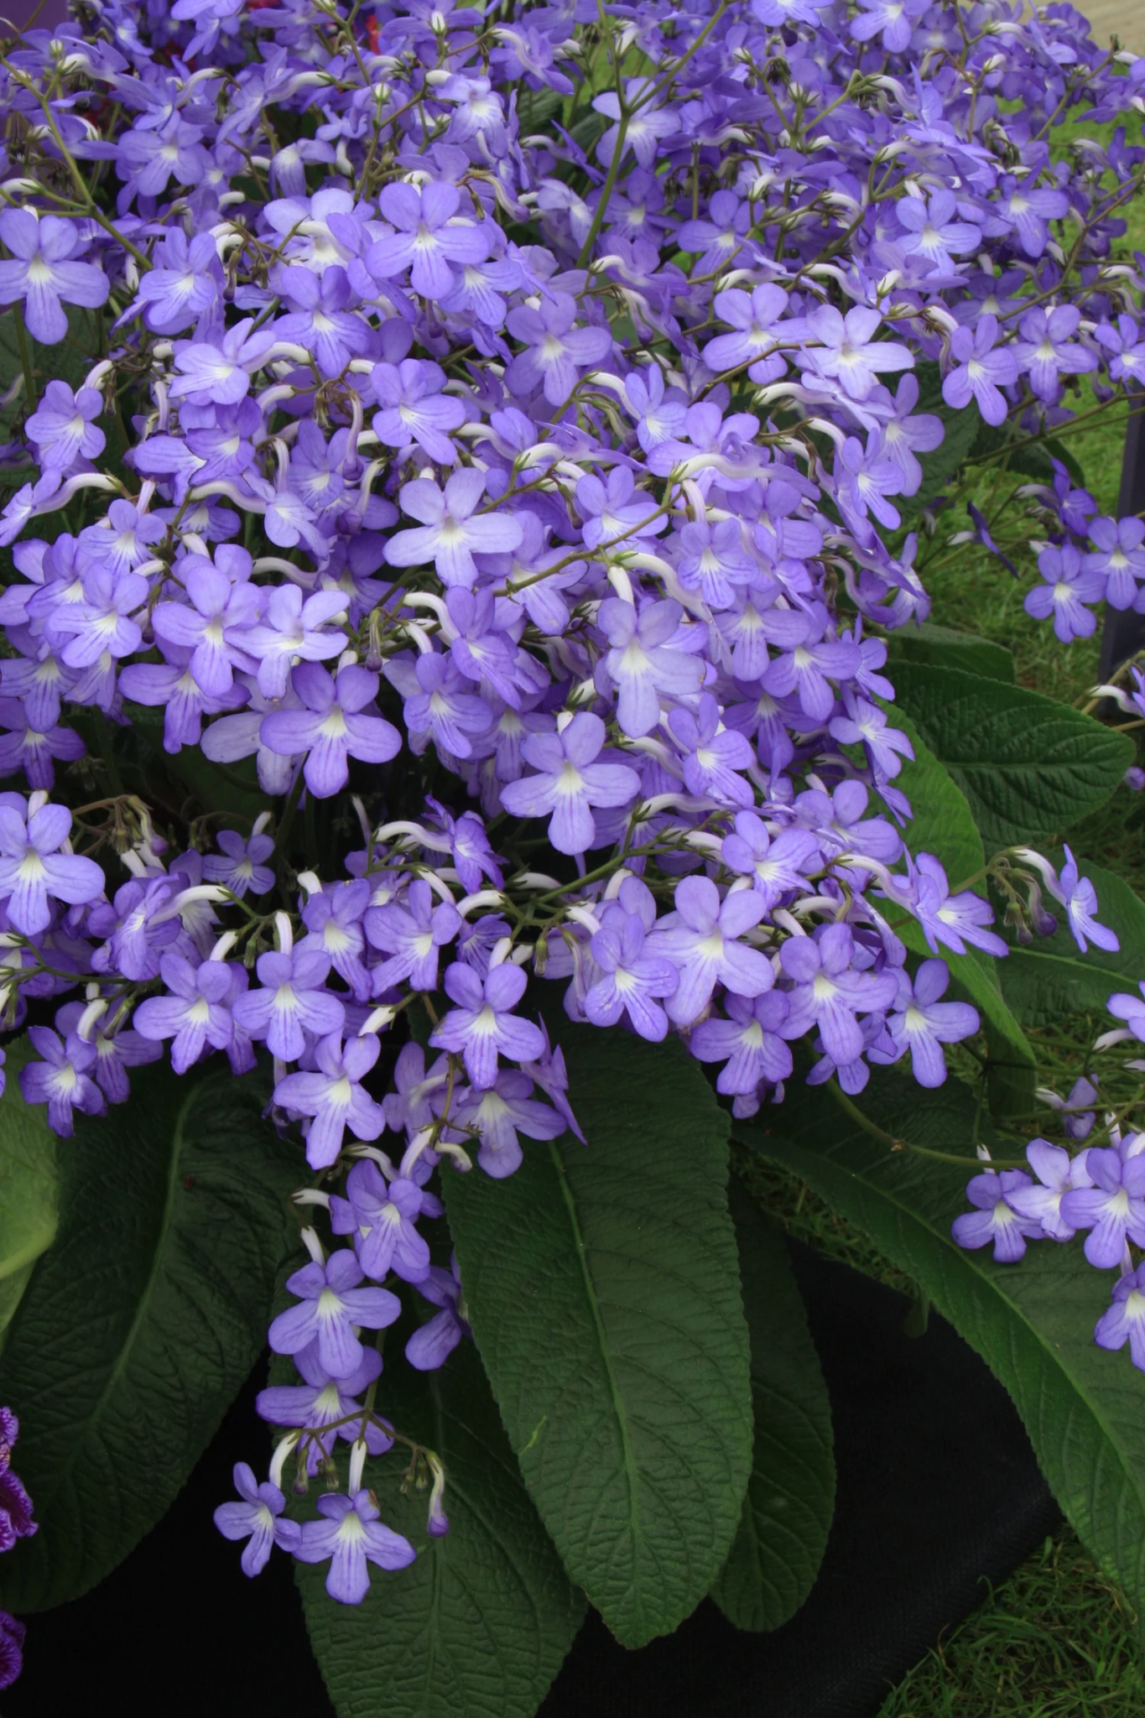
Discovery of Falling Stars
At Dibleys nursery in North Wales, S. johannis sported to give a darker blue flowers on much shorter peduncle. Like the species, it can produce enormous numbers of flowers, each inflorescence having 12 or more flowers. The flowers are small, sky blue, and are produced early in the season.
Excellent parent to many hybrids, giving offsprings that inherit compact, early, free flowing qualities.

Slide 9
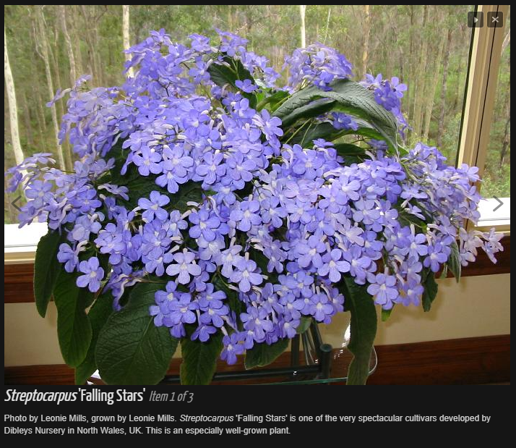

Slide 10
Staying Alive…….
Space
Air flow will prevent fungal infections
Repotting
Better to under pot than over, shallow roots, likes to be rootbound
Repot 1 inch up when roots are coming out of the bottom of the pot
Can be grown as a houseplant or outside
Good to 50 degrees Fahrenheit
Light
Bright light, but avoid afternoon sun
Water
Less water is better than overwatering
Watering will depend on growing conditions
Fertilizer
higher potassium: 1 to 2 ration N to P
Every two weeks, ¼ strength
Less in winter or dormancy
Deadheading
Remove spent flowers at the base

Slide 11
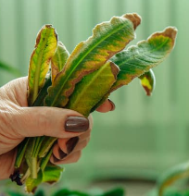
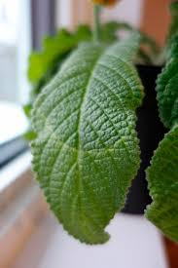
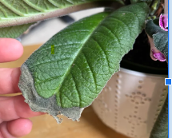
Troubleshooting
Leaves often die back from the tips
this is natural and happens especially towards Autumn
Distinct abscission zone occurs so that the end of the leaf goes yellow and dies off
Unsightly brown ends can be broken off with no harm to the plant.
Plant’s way of shutting down for winter
Brown spots
Sun damage
Cold water on leaves
Few flowers and large leaves
Not enough light

Slide 12
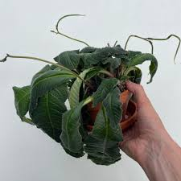
Resilient
Wilt - check the soil
if dry - it needs watered
if wet - it is overwater - check for root rot
If on individual leaf, remove at the crown and make sure any rot is removed
Rest period in winter, signs of dormancy equal less water

