Slide 1
LEDs and lighting
Basics of lighting

Slide 2
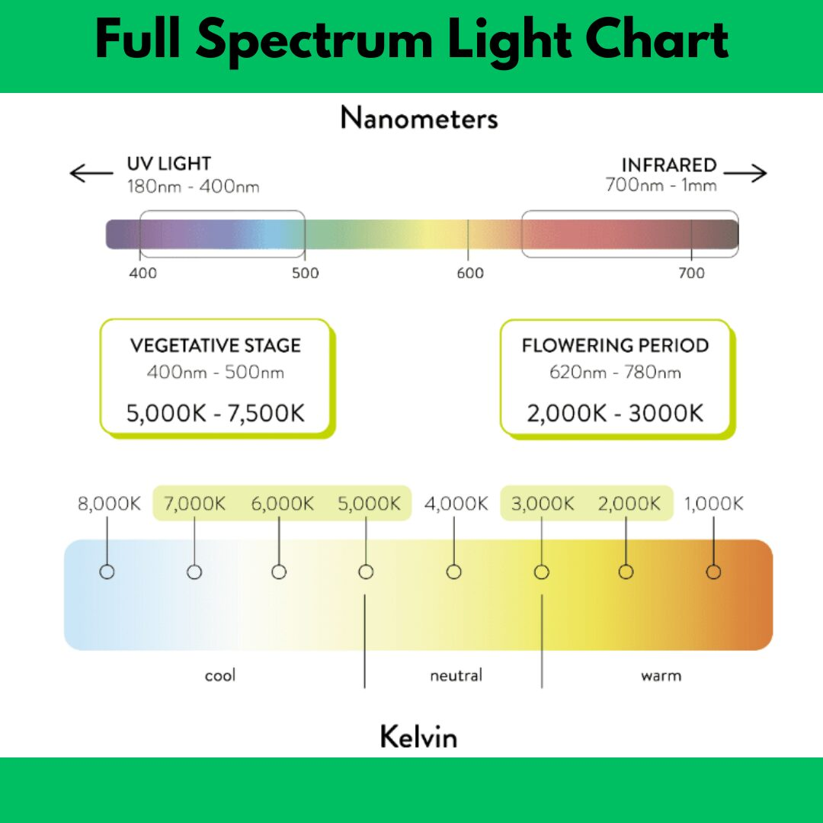

Slide 3
What types of lights are available?
Different Kind of lights
Blue - Produces Vegetative plant growth
Red - Produces the Flowering
White – Full Spectrum
Color 5000° - Morning light
Color 6500° - Mid Day light
Power Supplies

Slide 4
Nice to have tools
Micro Shears
Wire strippers
Pointy nose Pliers
Helping Hands to hold things
Tape
Liquid Tape Small Screw drivers Phillips and straight
Wire
Maybe solder
Solder Iron
Heat Gun

Slide 5
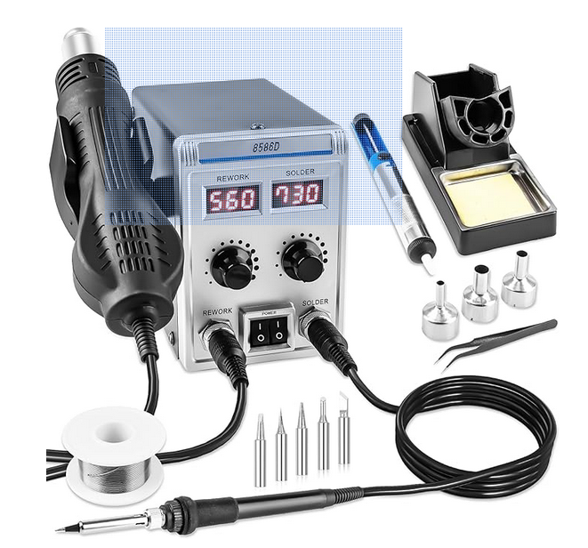
Soldering Iron
Heat Gun
Temperature controlled
Different tips
Different Nozzles

Slide 6
Whys to cover your electrical connections
Heat Shrink – What Kind
Heat Shrink with solder
Heat shrink comes in sizes and colors
Adhesive inside make a water tight connection
Wire nuts
Tape
Liquid Tape

Slide 7
Commercially available LEDs
Cleaner looking
Maybe less expensive
Maybe be dimmable
Would have to verify for sure Not always dimmable
Everything for a specific color.

Slide 8
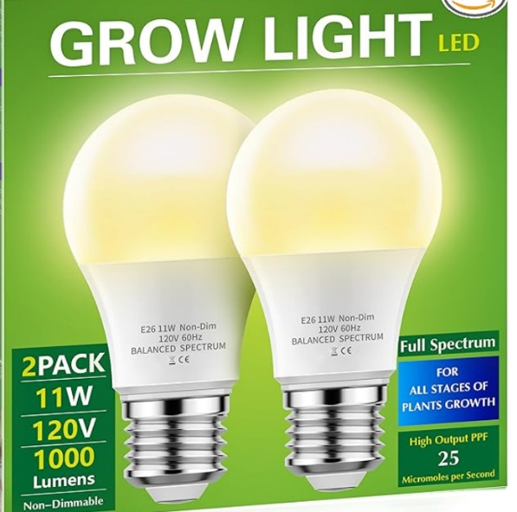
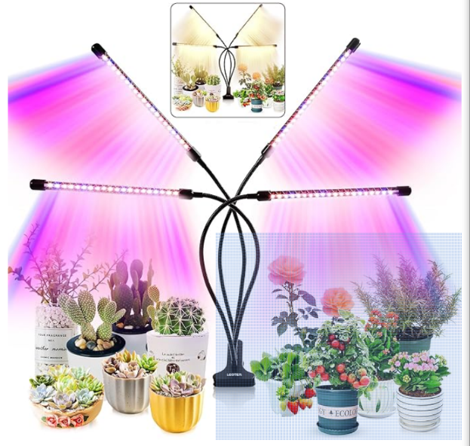
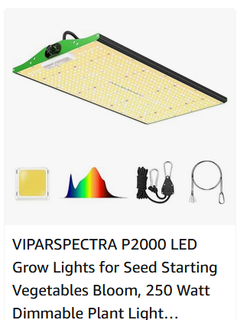
Grow lights
Pink
Full Spectrum
Red & Blue
Bulbs
Fluorescents

Slide 9
Dimming Capabilities
PWM – Pulse With Modulation
Types of Dimmers
The theory is the LED needs 100%
PWM turns on and off to only deliver a Percent of light
Not all leds have that capability as well.
4.5volts, 12volts, 24volts, 120volts

Slide 10
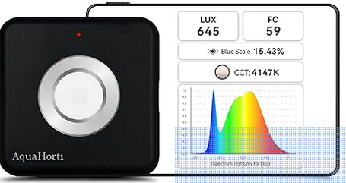
Light Meters
PAR
µmols/m²/second
LUX
Foot Candles
Temp/Color
Bluetooth
Cell phone App

Slide 11
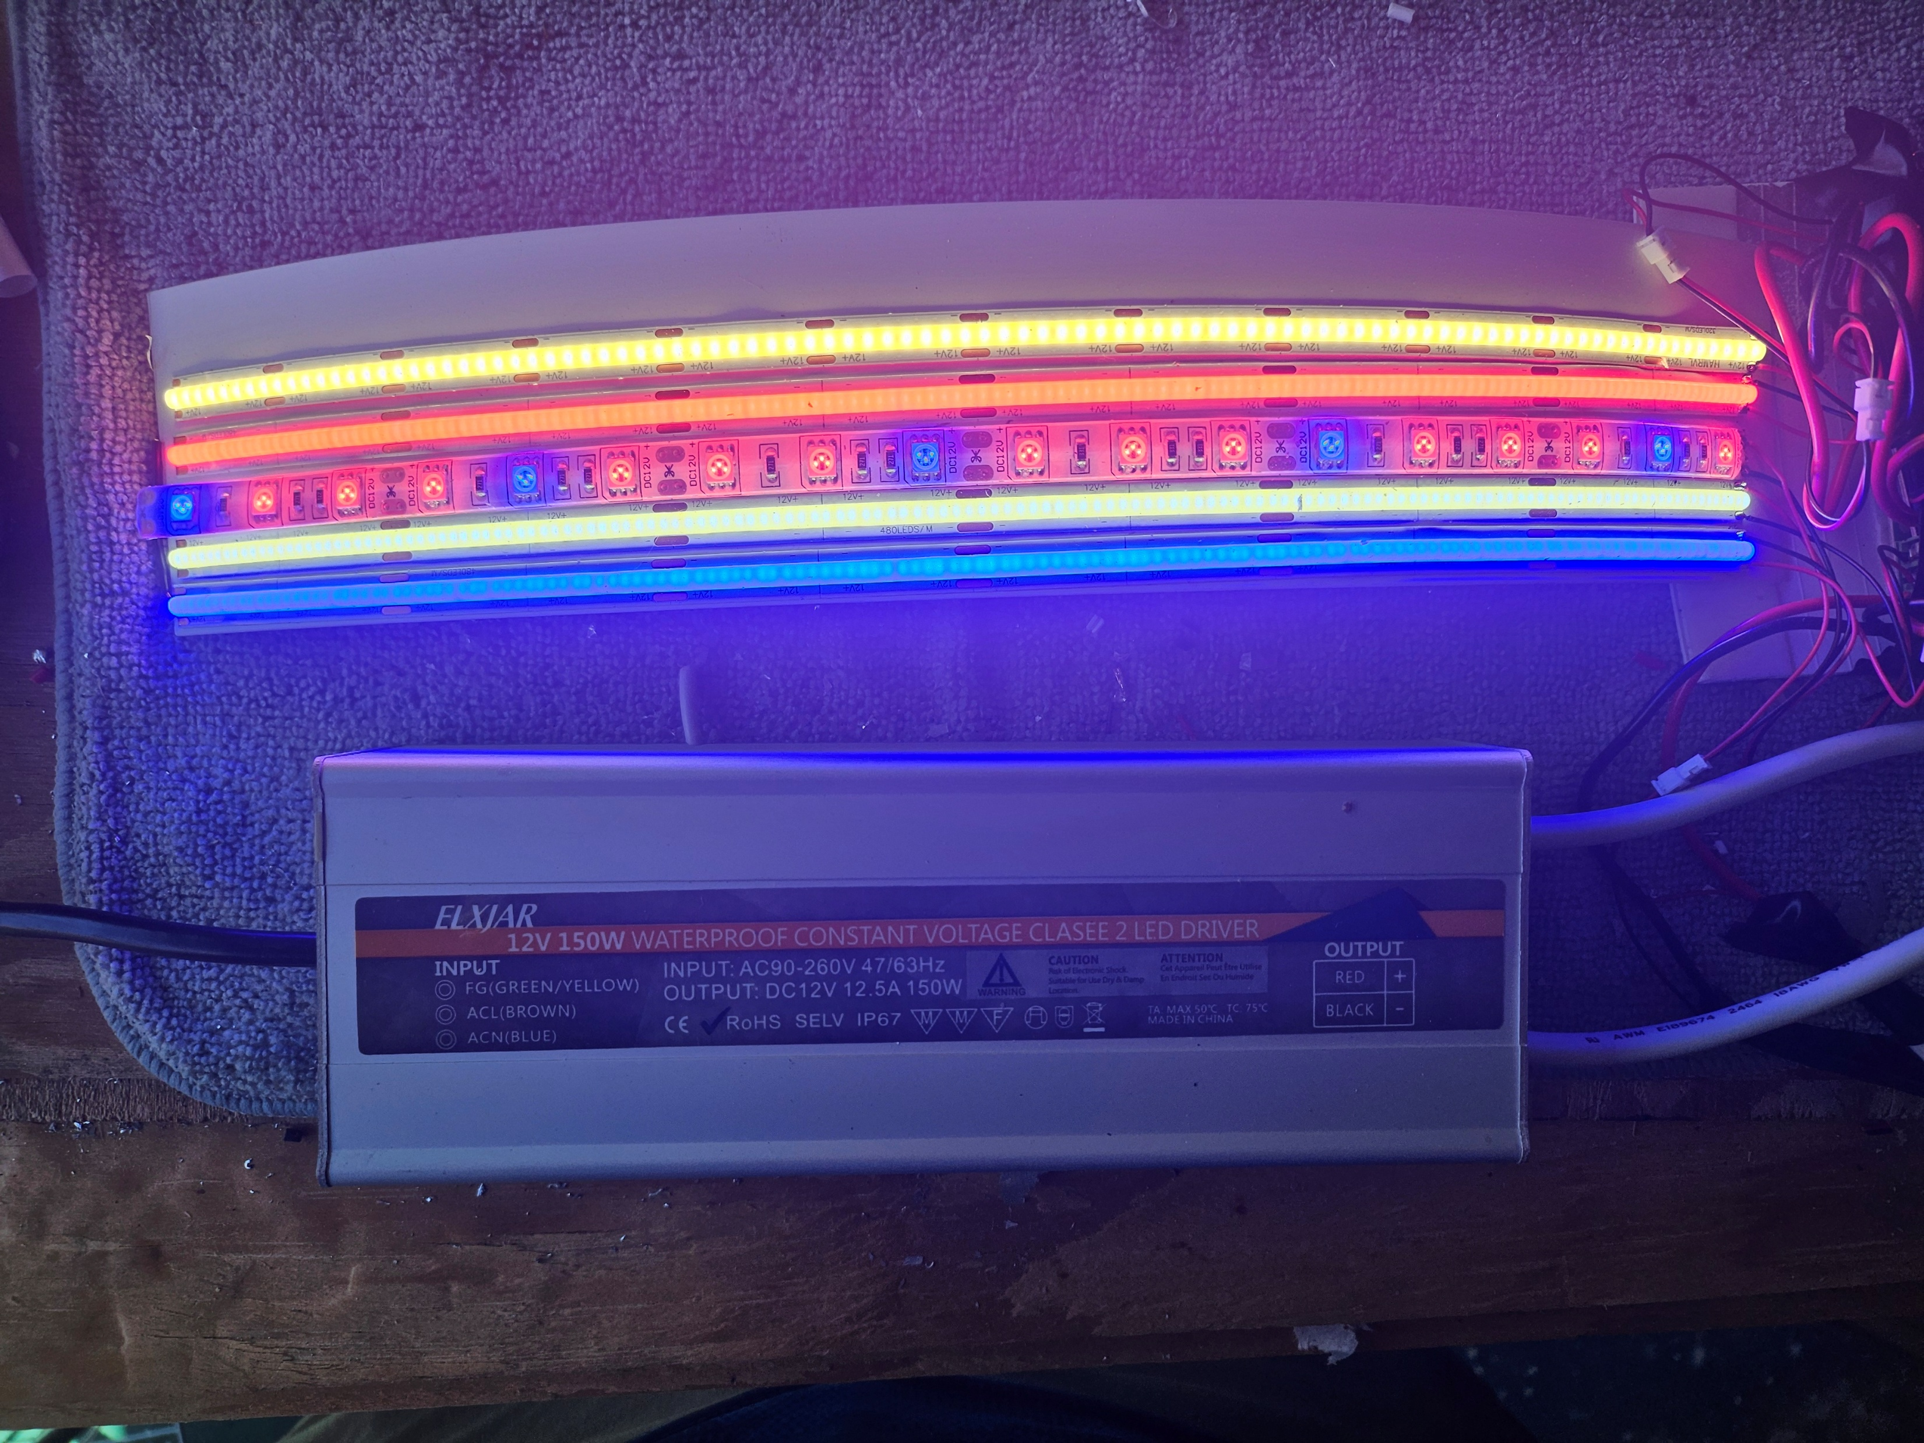
Lights and controls

Slide 12
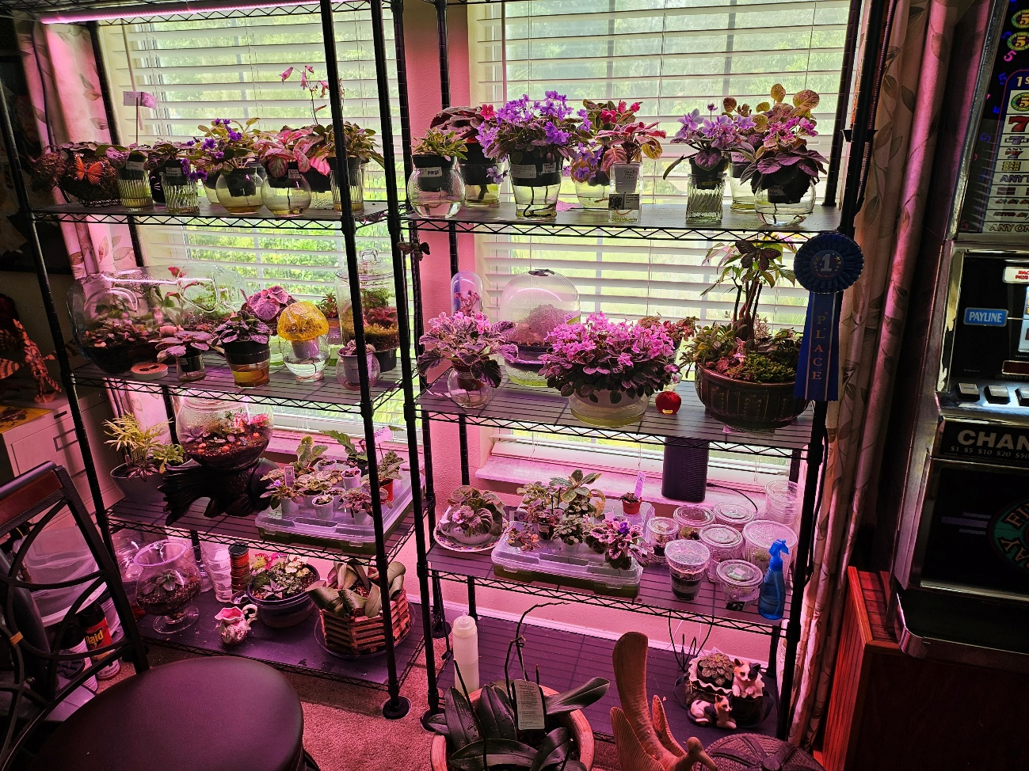
Micro Shears - Micro Shears
Red LED strip - Red Led COB Strip
White LED Stripe White Led COB Stripe
Blue LED stripe - Blue LED stripe
Solder Iron with heat gun - Solder Station
3 ft led grow lights Barrina - Barrina Lights
60/40 solder - solder
Helping Hands - Helping Hands
Heat shrink - Heat Shrink
Liquid Tape - Liquid Tape
How to Solder - How to Solder
Soldering LED light strips - Solder LED Light strips

Slide 13
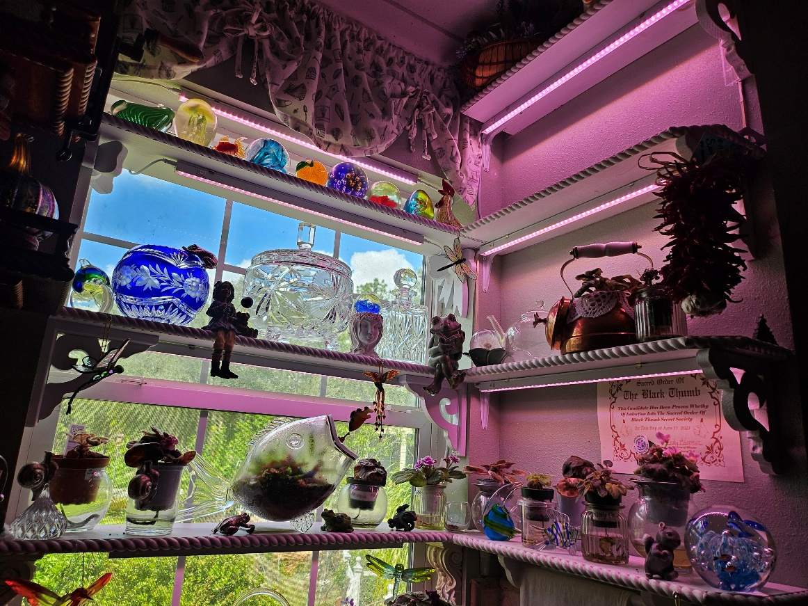
Kitchen Window
Living Room
Bed Room
Supplement what you already have if needed

Slide 14
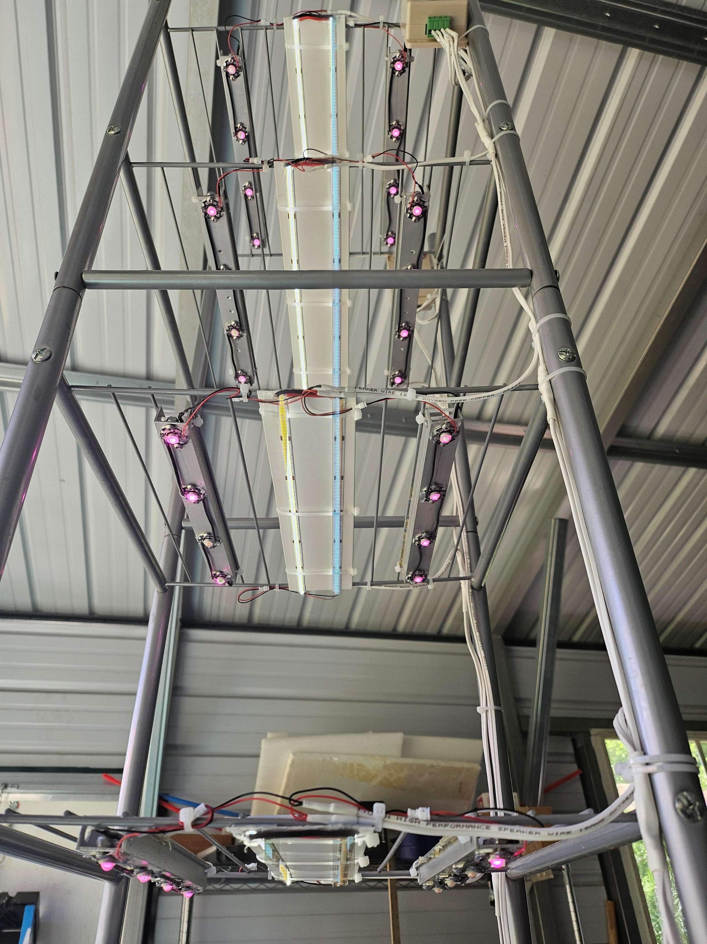
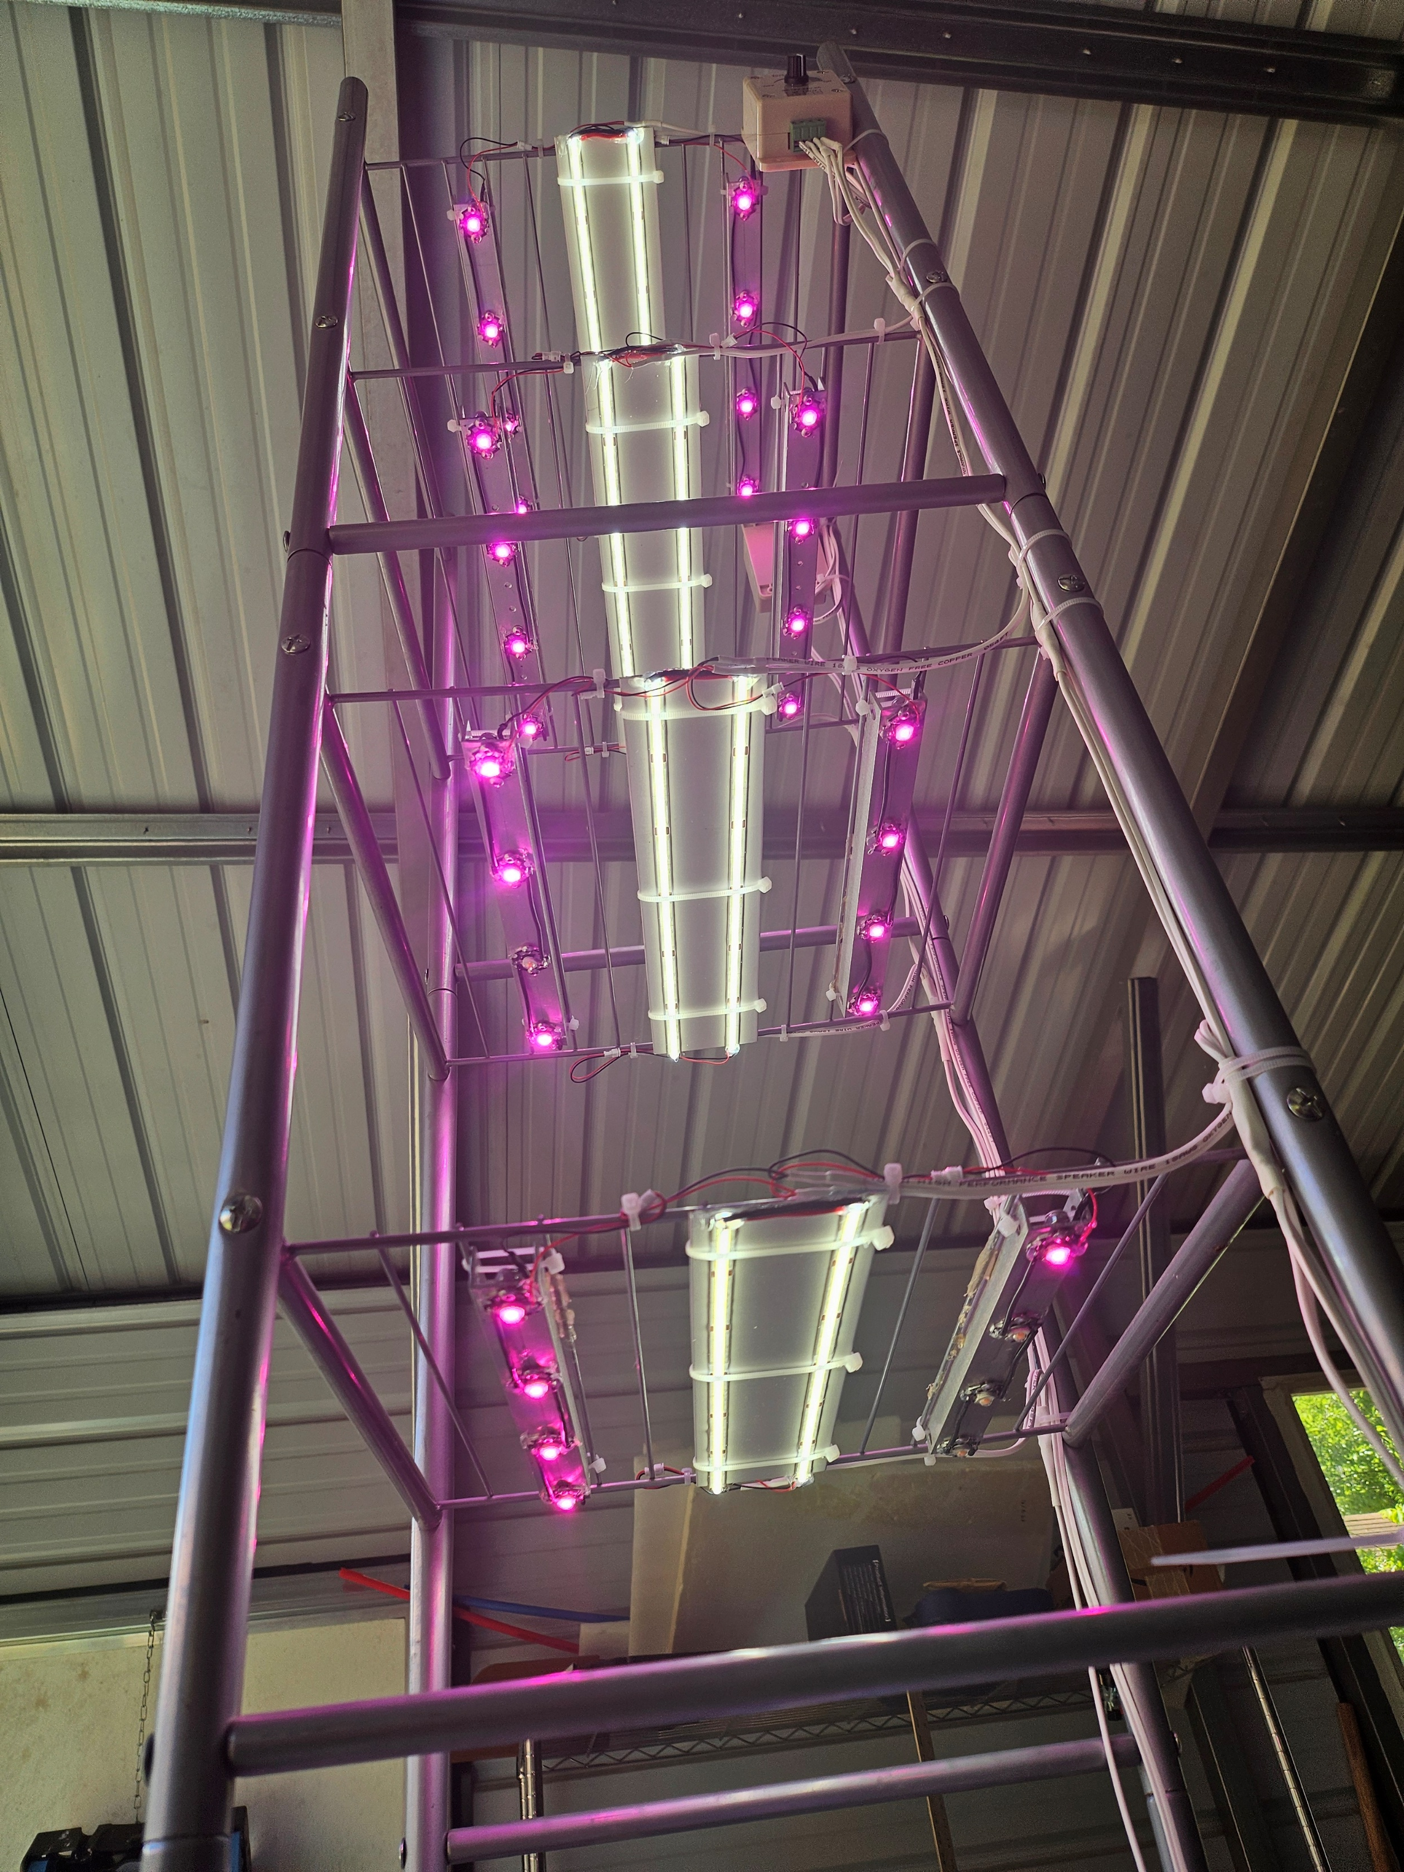
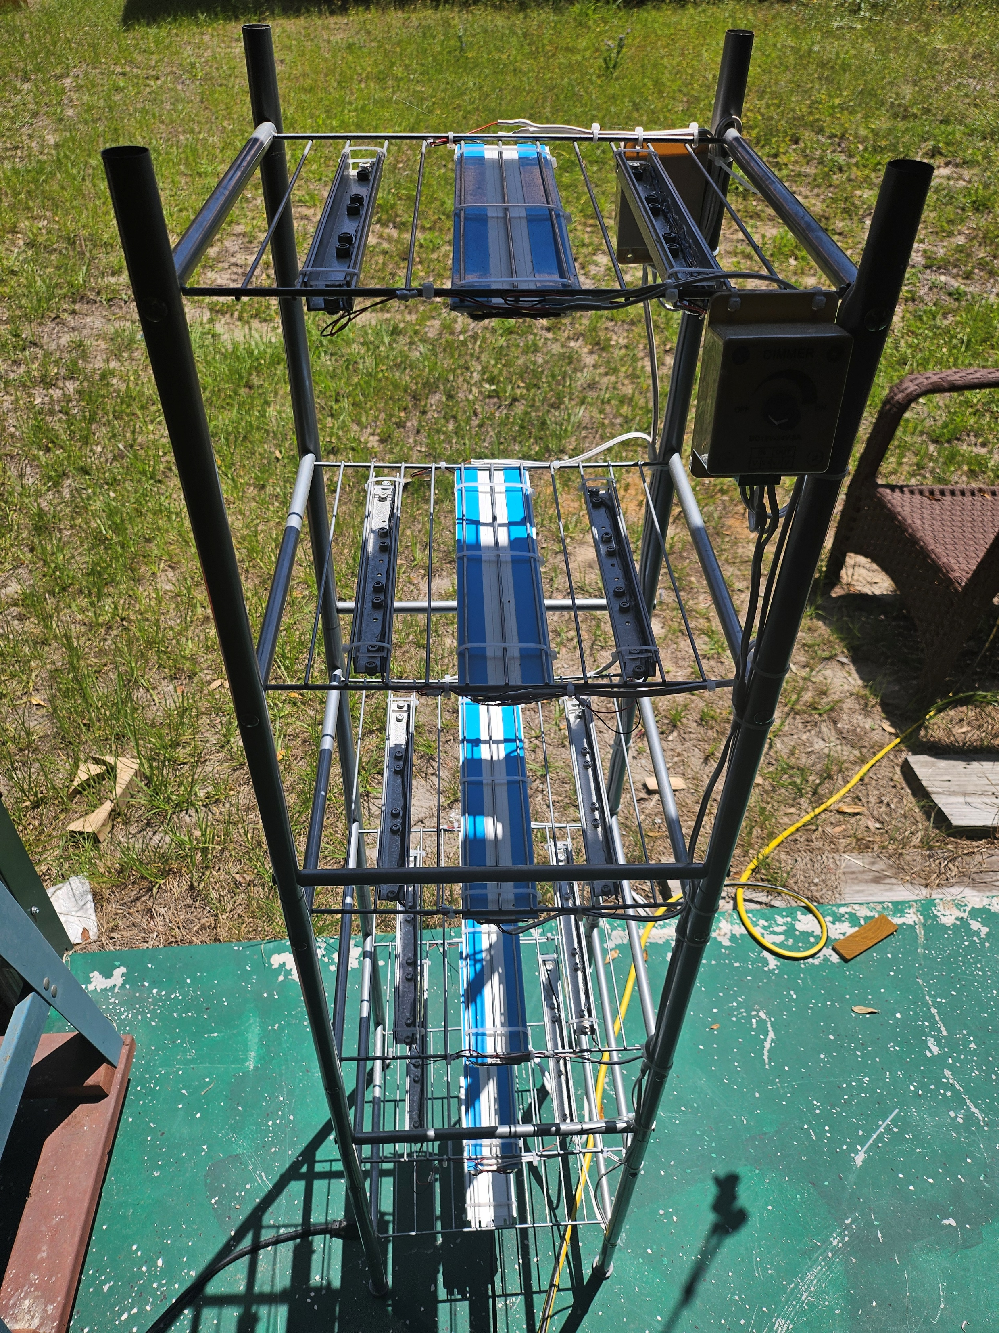
Ability to dim
Vary the lux to bright
Custom lighting is not always pretty

